Slide 1
Recovery Engagement
The Solution is in the Community

Slide 2
Introduction to ROSC
Recovery-oriented systems of care (ROSC) are networks of formal and informal services developed and mobilized to sustain long-term recovery for individuals and families impacted by severe substance use disorders.
The system in ROSC is not a treatment agency but a macro level organization of a community, a state, or a nation.
William White
We are moving from Systems that treat illnesses, and manage symptoms to…
improving lives and systems that are part of a larger network of supports

Slide 3
SAMHSA’s objectives are whole health and that is ROSC
Health—Overcoming or managing one’s disease(s) as well as living in a physically and emotionally healthy way;
Home—A stable and safe place to live that supports recovery;
Purpose—Meaningful daily activities, such as a job, school, volunteerism, family caretaking, or creative endeavors and the independence, income, and resources to participate in society; and
Community—Relationships and social networks that provide support, friendship, love, and hope.

Slide 4
The Problem or why ROSC
    Unmet Need for Services
      The national need for addiction treatment exceeds capacity and that trend is expected to continue.
      Only 1 of 10 individuals that needs addiction’s treatment receives it.
      Up to 80% of individuals in the criminal justice system suffer from a substance use disorder.
    Funding Challenges
      Both states and the federal government are cutting budgets.
      People with addictions are more likely to be poor and uninsured.
    Traditional Care does not match Client needs.
      People with addictions have COMPLEX treatment needs.
      Organizations treating addictions are SILOED.

Slide 5
The Solution…ROSC
Responsive to Provider Needs:
  Comprehensive supports for a complex patient population.
  Maximizes community volunteer and client
Responsive to Client Needs:
  Traditional care treats everyone with substance dependence the same.
  ROSC care treats everyone as individuals. Services, treatment plans are all based on the individual client’s Recovery Capital.
  ROSC is responsive to treatment history. A client that is appearing for treatment who has already been in an IOP 4 times likely needs something other than IOP.
Responsive to the Future of Behavioral Health Care:
  Budgetary pressures in the criminal justice system, healthcare reform opportunities and major changes in funding, are leading to rapid change in behavioral healthcare.
  The ROSC model proactively manages these changes & positions organizations to be seen as a community leader in the best position to coordinate community-based recovery care.

Slide 6
…Leads to Opportunities…
Very little infrastructure development for SUD services
High Cost of SUD’s to society
Health Care Reform/Parity
Payers demand change
Criminal Justice System
Extends beyond SUD to all Behavioral Health
Integrated Behavioral – Physical Health

Slide 7
…for All Stakeholders…
Goal: Help people with addiction challenges achieve change through abstinence and improved health, wellness, and quality of life.
Four Functional Objectives:
For Participants, improve outcomes.
For healthcare providers,
    Improve operational efficiency,
    Help meet Meaningful Use Stage 2,
    Support new payment models.
For payers, reduce costs and demonstrate better outcomes.
For communities, promote integration between behavioral health and physical healthcare, improve community partnerships/coordination for individuals with Substance Use Disorders and lower costs.

Slide 8
…with Measurable Outcomes
Usage:
  Frequency
  Duration
  Range/depth (what resources are used most)
  Source (extension of past programs vs new entry)
  Community participation
Outcomes:
  Days in recovery
  Personal goals achieved
  Reduced absenteeism
Cost of service delivery:
  Ratio of RC to Participants
  Average cost per Participant per mo/year
  Total number of Participants by source
Satisfaction measured by survey:
  Participants
  Recovery Coaches & Volunteers
  Community Resources
  Employers/Payers

Slide 9
Siloed Resources and Siloed Funding
Traditional supports require the client to navigate complex and disjointed silos of support.
Criminal Justice
CMHC & Addiction Treatment
Housing
Medical Care
12 Step Meetings
Jobs
DCS
… So on
Blended, individualized, and recovery oriented supports allow us to cut through silos.

Slide 10
Traditional Systems v. ROSC
Traditional Systems of Care | Recovery Oriented Systems of Care
Focus on action stage of change. | Focus on pre-action stages of change.
Progress through service continuum in linear manner. | Clients work with a team to meet their needs.
Serial episodes of disconnected care. | Continuity of healing relationships across episodes, programs, agencies and systems.
Client blamed/discharged for relapse. | Responsibility is placed on the services milieu.
Limited aftercare. | Continued support and early re-engagement.
Pain based motivation. | Hope based motivation.

Slide 11
Service Systems are not aligned with what we know works
If we really believed addiction was a chronic illness, we would not:
Create expectation that full recovery should be achieved from a single treatment episode
View prior treatment as indicative of poor prognosis
Extrude clients for becoming symptomatic
Treat addiction in serial episodes of disconnected treatment
Relegate aftercare to an afterthought
Terminate the service relationship following brief intervention

Slide 12
Justification for Change
What we are doing isn’t working (at least not best use of limited resources)
ROSC model offers a more comprehensive/focused set of supports that are individualized
Maximizes use of human resources within organization (don’t need to pay a therapist to develop Recovery Capital)
Current system is clogged because we are attempting to treat all clients in the same way.
A focus on the relationship between Clinical Treatment need and Recovery Capital allows for truly integrated and client specific treatment.

Slide 13
Recovery Capital
Personal RC
a. Physical: health, shelter, food, transportation, etc.
b. Human: values, knowledge, credentials, education, problem solving, self-awareness, self-esteem, self-efficacy (ability to manage self in high risk situations) hopefulness/optimism, purpose/meaning in life, interpersonal skills
Family/Social RC
a. Family: encompasses intimate relationships; family and kinship relationships (defined here non-traditionally, i.e. family of choice); and social relationships that are supportive of recovery efforts
b. Community: encompasses community attitudes/policies/resources related to addiction and recovery that promote the resolution of AOD problems
Cultural RC
a. Cultural: constitutes the local availability of culturally-prescribed pathways of recovery that resonate with particular individuals and families

Slide 14
Client Engagement
Vital to encouraging client success is engagement. By supporting the client in a person-centered approach to assessing need, the REC is able to support the client identify their priorities for recovery.
Specialty Addiction and Mental Health Practices. EBPs.ROSC. Life Skill Groups. Recovery Coaching. Peer Support.
Specialty, EBPs, Mental Health and Addiction Treatments.
High
Treatment Need
ROSC. Recovery Coaches. Peer Support. Life Skills Groups
No Treatment. Other Linkages.
Low
Recovery Capital
High

Slide 15
The 4 Quadrant Model
A decision making framework to determine the most effective mode of treatment.
For example, someone who has been in IOP 4 times and is returning for treatment, likely needs something other than IOP.
A one size model is disengaging. “We disengage clients by not giving them what they want or need”
It’s all about CLIENT ENGAGEMENT!!!

Slide 16

Community Engagement
Bloomington, Indiana REC
While the REC, in its former life, was an inpatient facility that saw under 100 consumers a year, as the hub of the ROSC, it now serves 4200 walk-in consumers per year. Services requested by consumers are:
  20% Support Service
  8% Employment
  7% Housing
  20% Support Groups
  20% Recovery Coaching
  4% Service Inquiries
  35% Informal Support
The Centerstone Recovery Engagement Center (REC) is a low-barrier point of entry into the recovery Community and involves Recovery Coaches, Peer Mentors, Peer Specialists and volunteers.
This is a hub of recovery that is not based in a facility but is instead a part of the community. The ability to partner and leverage other community resources and supports allows us to provide comprehensive services and address the diverse needs and interests of clients.

Slide 17
REC Service Offerings
Recovery Coaching
Safe Space / Sober Supports
Transitional Living Program
Employment Supports
Health and Wellness groups, activities, testing, etc.
12 Step Meetings (AA, NA, AL-ANON)
Medical Supports
Faith Based and Other Support Groups
Life Skills Training
Gardening
Events and Socialization Opportunities
3 Tier Volunteer System
Peer Mentors / Peer Support Specialists
(this is home, health, community and purpose)

Slide 18
Engagement
Just as consumer engagement in treatment is key to recovery, the community’s engagement in building a Recovery Oriented System of Care is absolutely essential.
Key to our success at the Recovery Engagement Center has been building a community of committed partners who are passionate about addictions and understand the costs in terms of human capital and dollars of untreated, undertreated substance use.
“The Recovery Engagement Center has been an amazing resource for the criminal justice system. If I have a defendant who needs anything, I can just send him to the REC and he is able to get everything he needs from day one.” – Bloomington, Indiana Judge

Slide 19
It’s all about rethinking your current business model
We must recognize our own silos
How are our services organized
Are we funding what works best for the population we are serving
How are we positioned for current realities and future possibilities
How are we positioned in the community we serve

Slide 20

Barriers to Accessing Supports
Geographic and transportation barriers to accessing the REC.
Some clients lack the resources to make it to a physical location consistently.
Some clients need basic support in domains of scheduling and follow-up.
Some clients are reluctant to seek help.
Virtual Engagement is the next step in increasing community connections, encouraging engagement, and offering a diversity of supports.

Slide 21
Extending the REC through eROSC
These supports work in combination with each other, not as an isolated alternative.
This system acknowledges financial, community level, systemic, and intrapersonal barriers to achieving individually defined “recovery”.
This system addresses the fundamental issue of isolated and siloed resources
REC, V-REC, and E-ROSC provide an ability to support the client to navigate the various community/government service structures.
Notes:
This model acknowledges that individuals need to be connected with real people in a real community. Simply stated, if you are going to engage individuals in a meaningful way there has to be more than an electronic connection.

Slide 22
The e-ROSC in a Nutshell
$840,000 over 3 years
In first 4 months of award, we have to create the e-ROSC with a HealthVault Solution Provider – making sure that client, community, & project staff needs are solicited & met.
In Yr 1, quarterly improvements of the e-ROSC, 1 new recovery coach, at least 25 new clients.
In Yr 2 & 3, 2 new recovery coaches , at least 150 people.
The e-ROSC will:
  Have web-enabled enrollment into the 5-county e-ROSC program
  Have a PHR component linked to HealthVault (will work with any existing HealthVault account).
  Have a Recovery Dashboard
  Have other neat features like a Recovery Calendar linked to texting alerts & online chat and support group options.

Slide 23

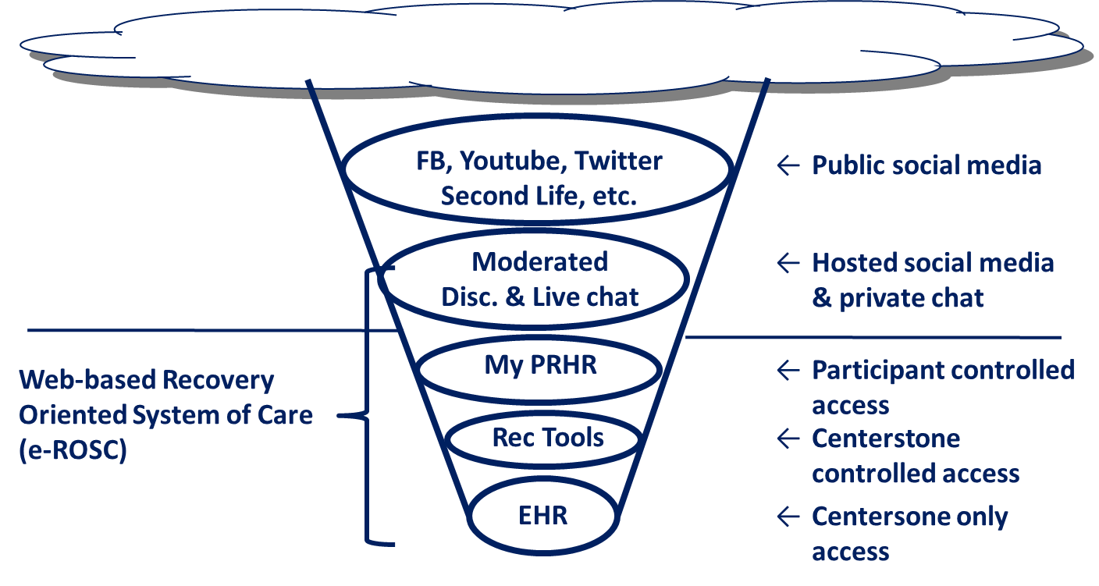
Overview

Slide 24
V-REC Content / Levels of Access
Community Level Open Access to Resources
Facebook, Youtube, Twitter, Second Life, etc.
Public Social Media
V-REC
Moderated Discussion &
Live Chat
Hosted social media & Private Chat
Request an Appointment
Direct Link to Services
Client Level Restricted Access to Treatment Resources
(Username and Password Required)
E-ROSC
My Personal Recovery Health Record
Owned by Client
Recovery Tools
Controlled by Centerstone / Used by Client
Electronic Health Record
Controlled by Centerstone

Slide 25
The 3 Domains of v-Recover.com
v-REC (Public Site)
Public Calendar
Announcements
Community Resources
Our View / What we Provide
Real Recovery
Gallery
The Rec Family
About
Moderated Discussion
Live Chat (with a Recovery Coach or volunteer)
Request an appointment
Addicted / Need Help?
Terms of Service and Privacy Policy
Code of Conduct
e-ROSC Recovery Center (Private Site)
Recovery Tools
(Centerstone controlled)
My Personal Health Record
(Participant controlled)
Recovery Plan
Weekly Update
Secure Message Center
Personal Calendar
Recovery Capital Scale
Medications
Conditions
Allergies
Immunizations
Apt Notes
Procedures
Notifications
Providers
Procedures
Observations
Emergency info
Tools

Slide 26





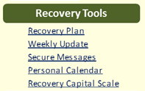



E-ROSC Environment Overview
Health Information Exchange
Modified BAA Provisions
Standard BAA Provisions

Slide 27
The 3 Domains of v-Recover.com
1. Community Level Open Access to Resources
Public Calendar
News / Announcements
Community Resources
Our View / What we Provide
Gallery
The REC Family
Moderated Discussion
Live Chat (Moderated by RC)
Request an Appointment
About Centerstone and V-REC
Real Recovery
Addicted / Need Help?
Terms of Service and Privacy
Code of Conduct
The V-REC is an electronic alternative to the physical location of the Recovery Engagement Center. The resources on this page are open to all citizens, including those in rural areas without immediate access to services in their area.
Individuals DO NOT need to be a CENTERSTONE client to utilize these resources, however they can inquire about services from this Domain.

Slide 28
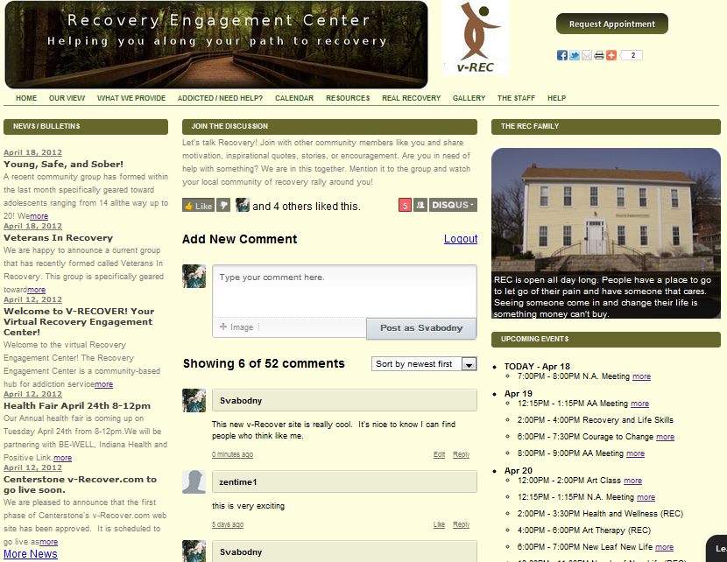



Slide 29
The 3 Domains of v-Recover.com
2. Client Level Restricted Access - Controlled by Client
(Username and Password Required)
Medications
Conditions
Allergies
Immunizations
Appointment Notes
Procedures
Notifications
Providers
Procedures
Observations
Emergency Information
Tools
While Clients are trained on this aspect of the E-ROSC--it is informed and input by them personally—it remains the property of the Client and not CENTERSTONE.
Content within this section of the E-ROSC is input and controlled by the client, not Centerstone

Slide 30
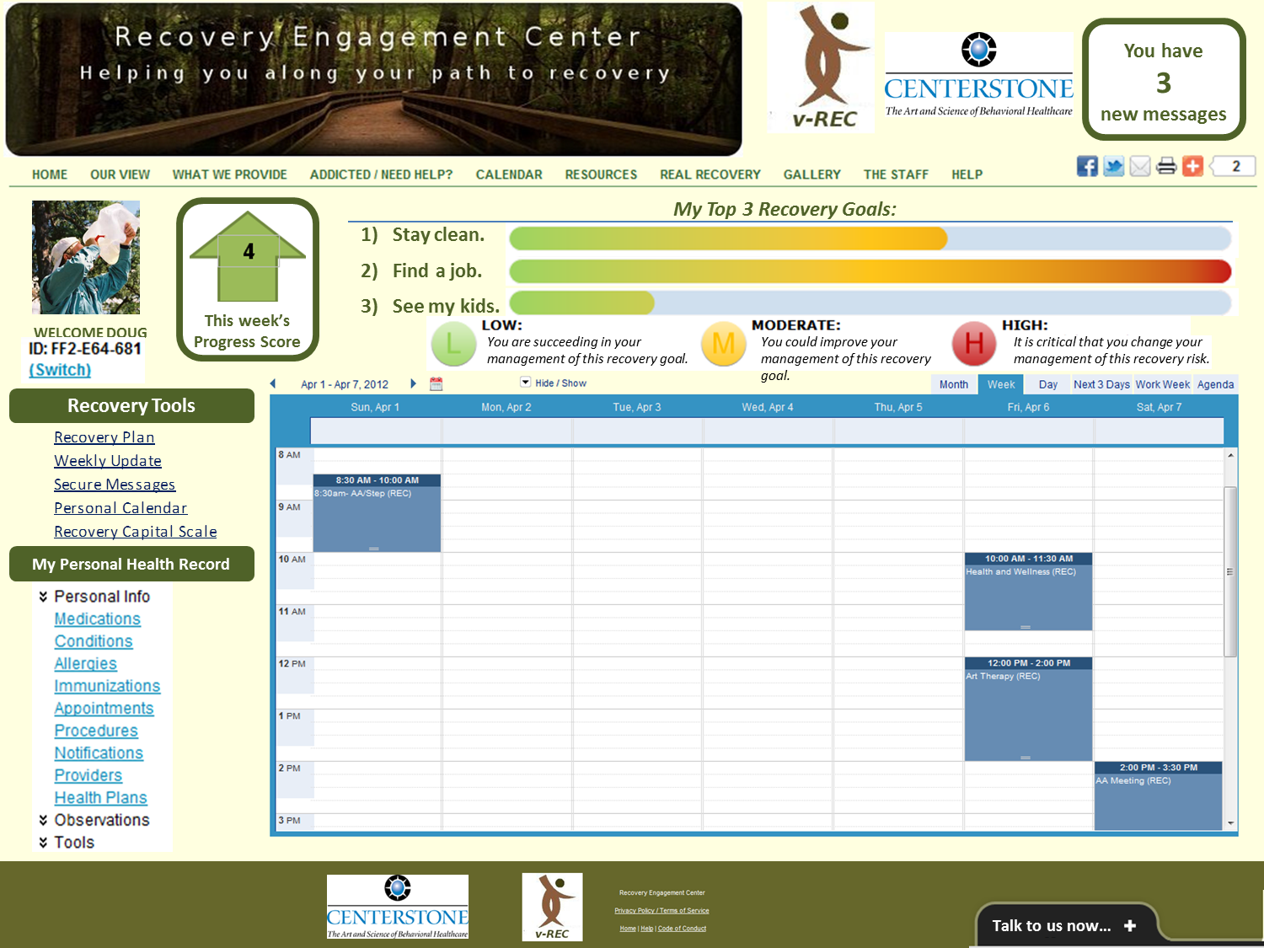
My Personal Recovery Health Record is a CLIENT OWNED method of tracking and maintain health information

Slide 31
The 3 Domains of v-Recover.com
3. Client Level Restricted Access - Controlled by Centerstone
(Username and Password Required)
Recovery Capital Scale
Recovery Plan
Weekly Update Documentation (TMAC)
Secure Message Center
Personal Calendar with Electronic Alerts
These Electronic Tools are a supplement to traditional supports (IOP, Treatment Meetings, etc.), as well as the ROSC supports that still occur at the Recovery Engagement Center.
Content within this section of the E-ROSC is controlled by Centerstone. Clients have the ability to participate and interact documents but ultimate control resides within the organization.

Slide 33
Recovery Support Tools
Recovery Capital Scale
Recovery Plan
Domains Assessed
Career / Education
Leisure/Recreation
Independence from Legal Problems
Employment / Financial Independence
Drug & Alcohol Recovery
Relationship/Social Support
Medical Health
Mental Wellness Spirituality
Mood / Confidence / Problem Solving
Treatment / Recovery Support
Goals Established in EACH DOMAIN for Recovery Planning, based on RCS Results
3 Priority Goals
Tools Continually Inform Each Other
TMAC
Risk v. Protective Scores
Work Made Toward Goals
Planning for Future Work
Informs Modifications to Recover Plan

Slide 34
RC and Client Training
After the intake process (GPRA and RCS) the Client creates a Recovery Plan with the Recovery Coach
The Recovery Coach will also train the client in how to use each aspect of the V-REC and E-ROSC, including:
  Navigating the Open Community (V-REC) Page
  E-ROSC Password Secured Client Page
  Managing Security Settings for Facebook and Private Information
  Telephone Monitoring and Adaptive Counseling (TMAC)
  Weekly Update Completion / Score Tracker
  Secure Messaging
  Recovery Calendar with Text Reminders

Slide 35
Recovery Tools are those materials that are used by the Client and the Recovery Coach to plan, organize, and direct Recovery Supports.

Slide 36
Recovery Capital Scale (RCS)
Addresses aspects of life domains considered important for recovery.
Clients respond on a 1 to 5 Likert scale, with 5 meaning “Strongly Agree” and 1 meaning “Strongly Disagree”.
Based on scores, domains are automatically identified as “High Risk” or “Stable” and auto-populate the Recovery Plan document.
Administration of the RCS will occur approximately every 6 months
Completed electronically within the Recovery Tools on the Secured Client E-ROSC page.

Slide 37
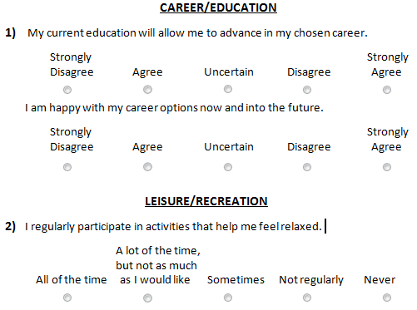

Slide 38
Recovery Plan
Developed with the Recovery Coach, this plan identifies Goals and Action Steps within each domain addressed by the RCS.
Priorities will auto-populate based on the scores of the RCS
Client and Recovery Coach will have the ability to edit all entries, including those auto populated.
Client and Recovery Coach will identify “Priority Goals” which will be the main focus of sessions, but all goals can be addressed and worked on.
Priority Goals will auto-populate into TMAC and progress assessed on regular intervals.
When a goal is accomplished, Priority or otherwise, it can be changed or modified.
The Recovery Plan is a living / changeable document.

Slide 39
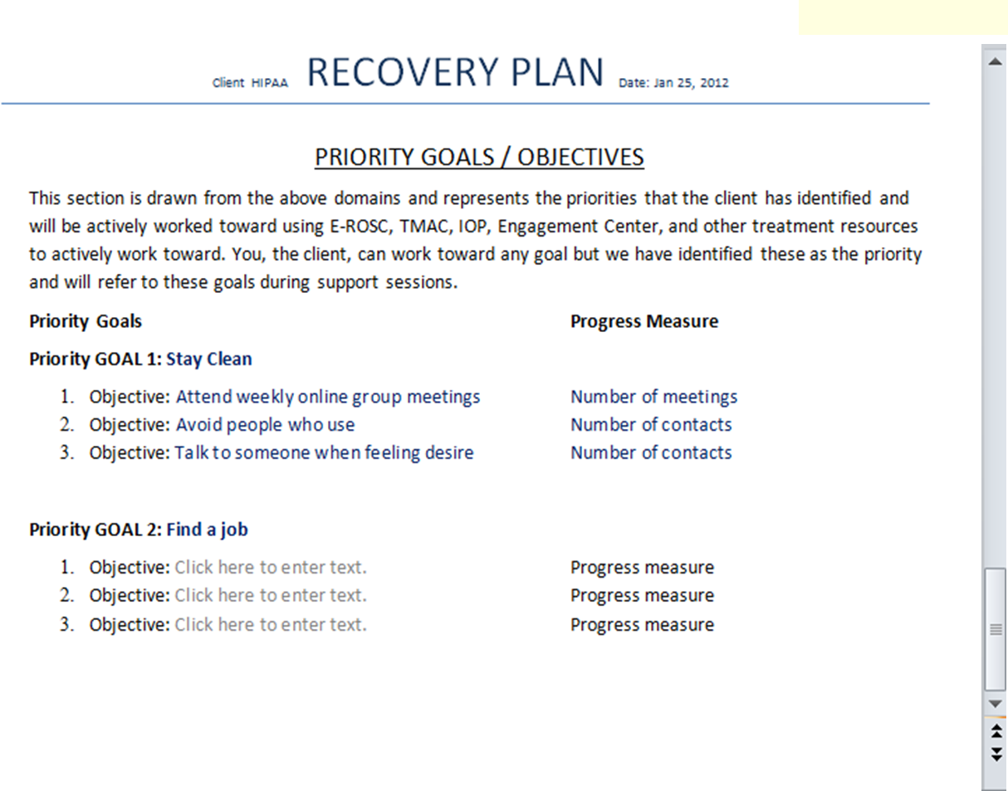

Slide 40
Weekly Update/Telephone Monitoring and Adaptive Counseling (TMAC)
TMAC is manual-driven and combines elements of low-intensity monitoring, social support, and adaptive levels of motivational interviewing (MI) counseling and cognitive-behavioral therapy (CBT) in response to a client's risk level for relapse measured at the start of each session by a structured 10-item interview.
Drawing heavily from Wagner's Chronic Care Model, TMAC focuses on supporting patient self-management, linking patients to community resources, using cognitive-behavioral strategies to increase self-confidence and skill levels, setting goals, identifying barriers to achieving goals, and developing strategies to overcome these barriers.
NREPP

Slide 41
TMAC (Weekly Update Tool)
Telephonic Monitoring and Adaptive Counseling is an EBP based in CBT theory.
Involves highly structured phone sessions at regular intervals.
  Sessions begin weekly and then move to bi weekly (at 2-3 months) and monthly at (6-10 months).
Client participates in Electronic “Pre-Phone Session Questionnaire” prior to session.
Client and Recovery Coach discuss, Emergencies, Questionnaire Responses, Goal Work, and Upcoming Strategies.
  Changes made to Recovery Plan as needed.
Risk and Protective Scores are measured and recorded each week—tracked over long-term to assess change over time.

Slide 42
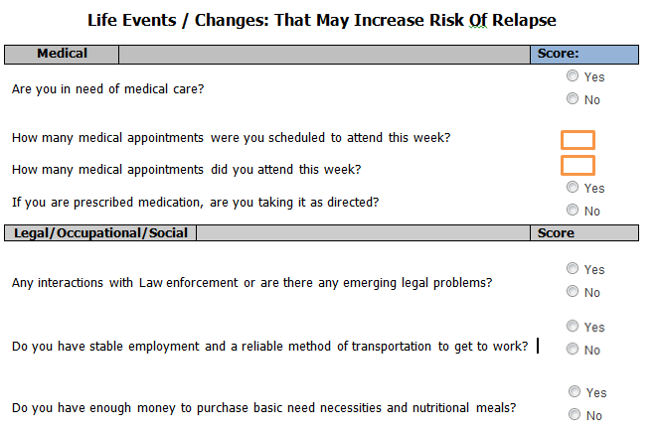
Client view allows for Yes/No and simple numerical responses. No scoring occurs in this view.

Slide 43
Measurement Outcomes of TMAC
Risk and Protective Scores can be tracked over time and visually represented on the Client’s secured E-ROSC page.
+4
This Week’s Progress Score
The arrow graphic represents the relative distance and change between Risk and Protective Factor Scores

Slide 44

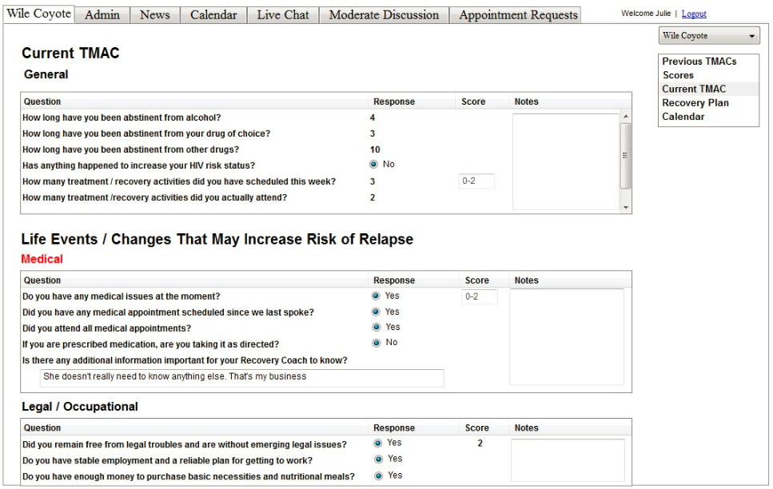

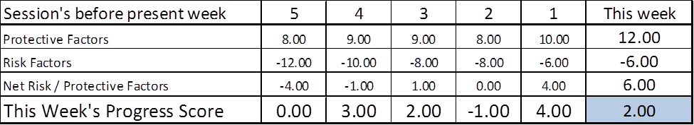
Recovery Coach view of the completed TMAC Assessment allows for adjusted scoring, notes, and comparison to previous weeks.

Slide 45
Recovery Coach Monitoring
Recovery Coaches are able to monitor Client activity, including:
Completion of TMAC Weekly Update
Work towards goals
Personal Recovery Calendar
Scheduled / Completed Treatment
This monitoring offers a level of support not available in traditional Recovery Systems. The Client and RC are working in an electronic and collaborative system of support.

Slide 46
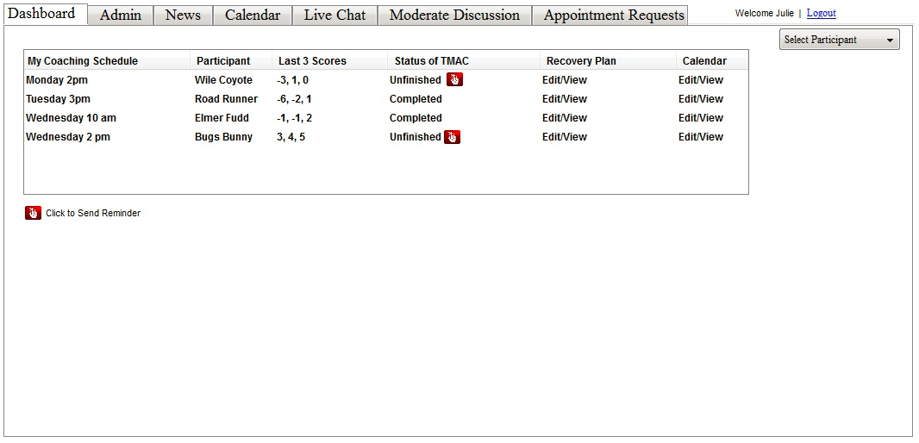

Slide 47
Next Steps…
Complete project and study according to grant with a focus on community engagement.
Expand SUD program beyond first 150 in Indiana
Continue collaboration with Be Well to bridge Behavioral/Physical Health
  Hep C
  Pregnancy
Extend to other Behavioral Health domains
  PTSD
  Depression
  At risk youth
Extend to other Centerstone communities
Publish and present

Slide 48
Conclusion
E-ROSC is the logical response to the economic, regulatory and technological world today.
E-ROSC contributes to sustainability of Behavioral Health delivery models.
E-ROSC allows us to penetrate markets we have been unable to access previously
E-ROSC will improve outcomes and lower cost, giving value to everyone.

