Slide 1
Building communities of recovery: PHILADELPHIA

Slide 2






Welcome to Philadelphia A City of Innovation
We hold these truths to be self-evident, that all are created equal, that they are endowed by their Creator with certain unalienable Rights, that among these are Life, Liberty and the pursuit of Recovery.
COMMUNITY BEHAVIORAL HEALTH
received the 1999 Innovations in American Government Award, presented by the Ford Foundation and the John F. Kennedy School of Government at Harvard University.
Philadelphia’s School of the Future

Slide 3
We will stand as a people with a shared past and a shared destiny declaring to all: “If we can heal, you can heal. If we and our families can heal, then neighborhoods and communities can heal. And if communities can heal, then the wounds of our country and the world can also heal.”
William White
Author, Slaying the Dragon: The History of Addiction Treatment and Recovery in America

Slide 4
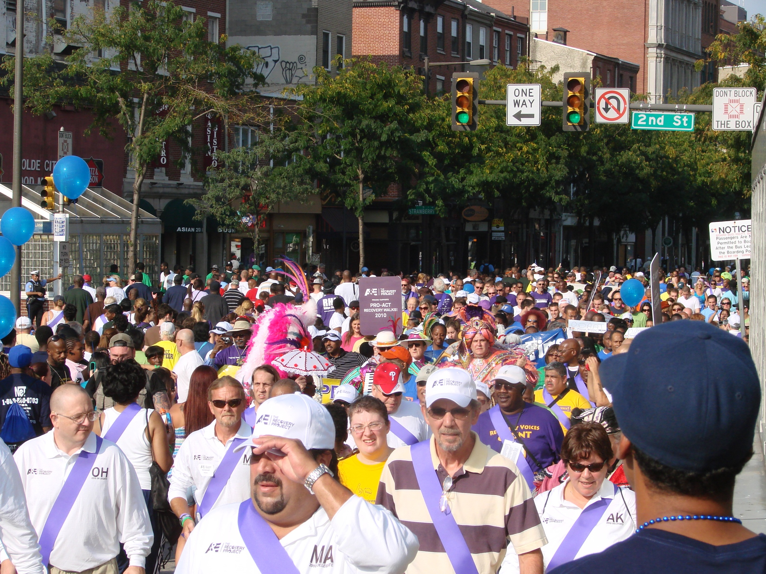

Slide 5
Agenda
Concept
Vision & Values
The need to transform
The future of the past and the present
What is important to consider
High Performing Collaborations & Partnerships
People in recovery & Families
Providers
Stakeholders
Systems
Assertive Community Linkages
Identifying the different communities
Inclusion of all in the community
Community assests

Slide 6
Agenda
Practice
Focused Interventions
Evidence Based Practice
Practice validating evidence
Addressing disparities in care
Diversity acknowledging
Trauma informed
Integrated Health Care
Behaviorally integrated
Healthcare integrated
Recovery integrated
Context
Recovery Champions
At every level organizational
At every level professionally
At every level politically
At every level financially

Slide 7
Recovery Oriented Systems of Care: An Overview
Key Questions
What is a Recovery Oriented System of Care (ROSC)?
Why Change What We Got?
Who benefits from a Recovery Orientation?
What does it mean to Transform?
Why is Transformation so hard?
What in the world is Philadelphia doing?

Slide 8
Shared Perspectives
Sheffield England
Philadelphia PA USA
Area
        City & Metropolitan borough 142.06 sq mi (367.94 km)
        Population (2011 est.)
        City & Metropolitan borough 552,700 (Ranked 3rd)
• Density 3,890/sq mi (1,502/km)
• Urban 640,720
(Sheffield urban area)
• Urban density 10,228/sq mi (3,949.2/km²)
        County 1,292,900
Area • Consolidated City County 142.6 sq mi (369 km)
Population (2010 census)
• Consolidated City County 1,526,006 (5th)
• Density 11,457/sq mi (4,405.4/km)
• Urban 5,325,000
• Metro 5,965,343
• CSA 6,385,461

Slide 9
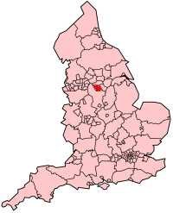
Sheffield
Area • City & Metropolitan borough 142.06 sq mi (367.94 km²) Population (2011 est.) • City & Metropolitan borough 552,700 (Ranked 3rd) • Density 3,890/sq mi (1,502/km²) • Urban 640,720
(Sheffield urban area) • Urban density 10,228/sq mi (3,949.2/km²) • County 1
,292,900
Demonym Sheffielders

Slide 10
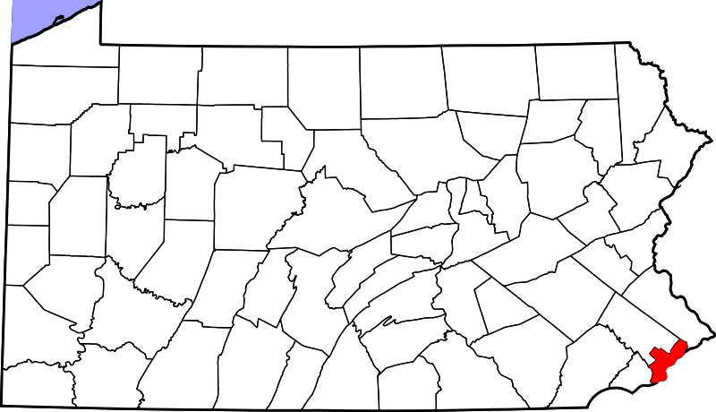
Philadelphia
Area • Consolidated city-county 142.6 sq mi (369 km²)
• Land 135.1 sq mi (326.144 km²)
• Water 7.5 sq mi (19.6 km²)
• Urban 1,799.5 sq mi (4,660.7 km²)
• Metro 4,629 sq mi (11,989 km²)
Elevation 39 ft (12 m)
Population (2010 census) • Consolidated city-county 1,526,006 (5th)
• Density 11,457/sq mi (4,405.4/km²)
• Urban 5,325,000
• Metro 5,965,343
• CSA 6,385,461 •
Demonym Philadelphian

Slide 11
Historically, Philadelphia has been a good system of care
Country’s first Municipality run Managed Care Organization, 1996
          1999 received Innovations in American Government Award
An Integrated Behavioral Health Care System? In 2004:
          Over two hundred providers operating several hundred facilities
          Access at every Level Of Care (LOC)
          Diverse service types
          Managing $1.2 Billion for Behavioral Health
          Serving over 100,000 persons annually

Slide 12
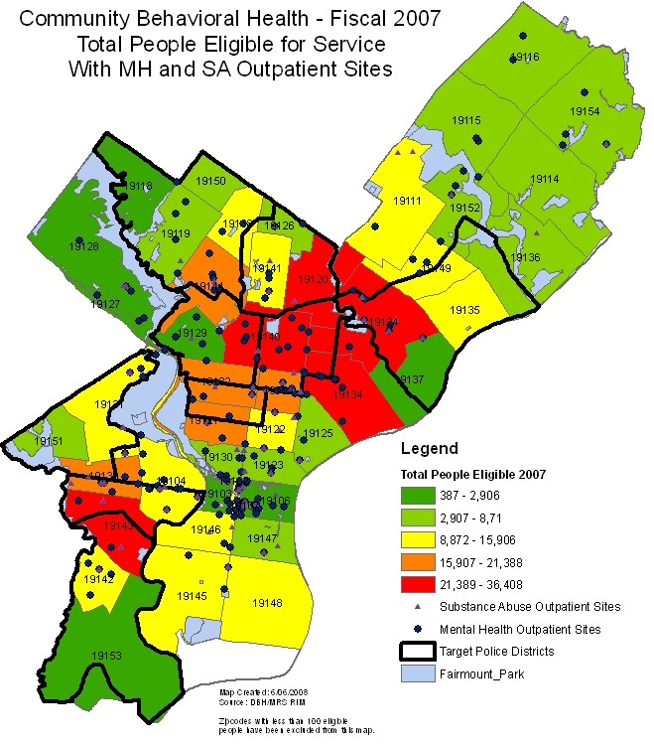
Historically A Treatment Rich Environment
Notes:
12
1. Insert map regarding numbers served in outpatient or penetration rate of outpatient
2. Include counts for numbers served by outpatient

Slide 13

Historically Addiction Services
  The number of providers in 2005 licensed to provide AOD treatment in the DBH/MRS was approximately 64 operating approximately 182 programs.
  Providers had been separately contracted for addiction services by many different funders all with a different perspective on addiction, i.e. MH, Managed Care, County D&A authority.
  Abuse/Dependence/Addiction treatment services for children and adolescents were not comprehensive.
  The fragmented system results in:
          gaps in levels of care,
          Inconsistent screening & assessment
          inconsistent service delivery,
          inadequate dosages of care, & general difficulty accessing care in a timely fashion.
Notes:
13

Slide 14
Treatment Services (2004)
In a city of what was then 1.4 mil:
Detoxification (14 facilities /240 beds)
Hospital-Based Residential Rehabilitation (4 facilities / 20 beds)
Non-Hospital Residential Rehabilitation (62 facilities / 2058 beds)
Halfway House (4 facilities / 92 beds)
Outpatient – Drug Free (76/ 8,000 slots approx)
Methadone (11 Providers / 4400 slots approx)
Intensive Outpatient (50 facilities /5,648 slots approx )
All Level of Care determinations are made by using the Pennsylvania Client Placement Criteria (PCPC) for adults. The American Society of Addiction Medicine (ASAM) tool is used for adolescents.
Programs providing any level of treatment services are licensed by the Pennsylvania Department of Health, Division of Drug and Alcohol Program Licensure.
Notes:
14

Slide 15

Despite Our Richness Approaching Problems

Slide 16
Philadelphia Census Data
1,470,150 population (year 2004 update)
53.8 % female
47.0 % White
41.7 % Black / African-American
4.4 % Asian
5.0 % Other Race
1.5 % Two or more races
7.3 % Hispanic or Latino origin (any race)
Families below poverty level - 2000 = 18.4 %
Families below poverty level – 2004 = 24.2%
Sources: U.S. Census Bureau
2004 American Community

Slide 17
Prevalence survey: dependence or abuse in the past year, age 12 and older
2004 -2005-2006 Samhsa/OAS/NSDUH | Philadelphia | Pennsylvania | Total US
Illicit Drug Dep/Abuse Past Year | 3.39 | 2.56 | 2.91
Alcohol Dep/Abuse Past Year | 7.77 | 7.13 | 7.79
illicit drug or alcohol dependence or abuse | 9.78 | 8.52 | 9.24

Slide 18
Mortality with the presence of selected drugs 2000 to 2005
Source: Philadelphia Medical Examiner’s Office

Slide 19
Mortality with the
Presence of Drugs
1970 to 2006
1153
904
158
129
Source: Philadelphia Medical Examiner’s Office

Slide 20
Rational For Transformation
The system provides access on demand, but movement through the continuum is fragmented.
Treatment though improved, still does not adequately address long term recovery needs.
Recidivism within 60 days of discharge in detox and residential
Office of Addiction Services
Source: City of Philadelphia, Department of Behavioral Health Intellectual disABILITY services

Slide 21
A Rational For Transformation
Those seeking care are culturally and experientially diverse and the challenge they present are not sustainable in our traditional systems of care

Slide 22
Rational For Transformation
The cost of not managing from a recovery perspective is unsustainable. For example the Co-Occurring are:
32% of the Numbers But 65% of the Dollars

Slide 23
Adult Inpatient Psychiatric Admissions
Drug Screen Results
Source: City of Philadelphia, Department of Behavioral Health Intellectual disAbility Services

Slide 24
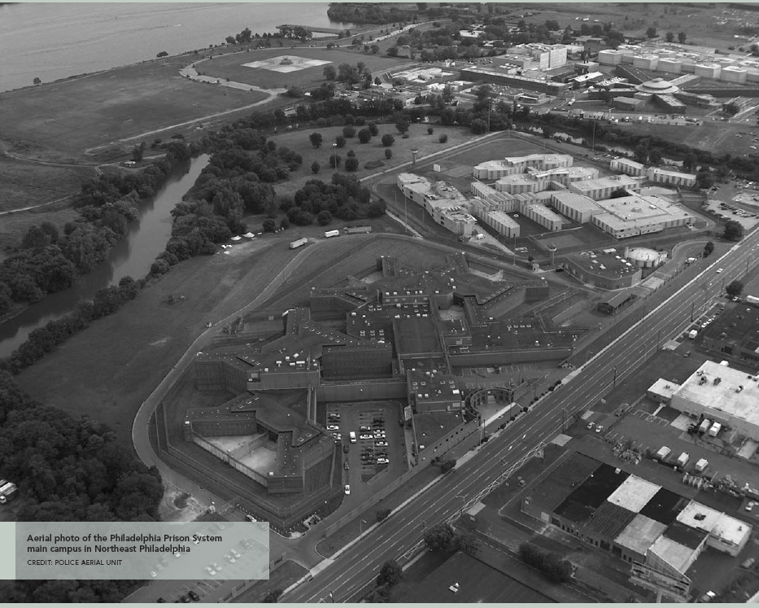
Rational For Transformation Phila. Prison System (FY 2005: 9000/5800)
Office of Addiction Services

Slide 25
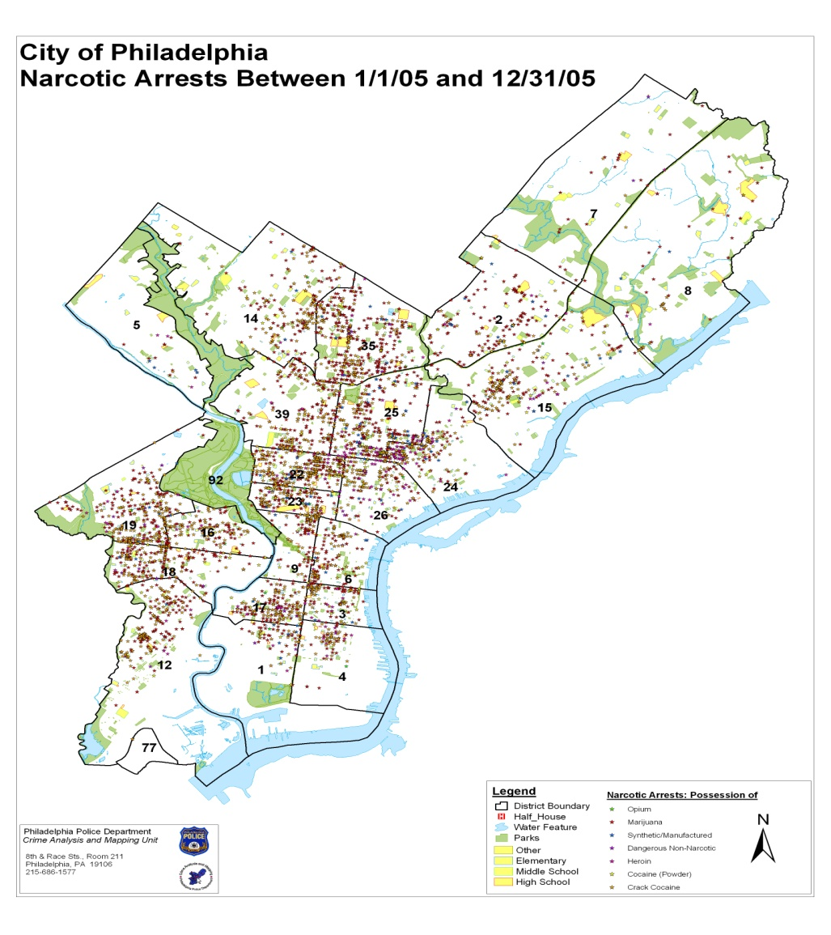
Rational For Transformation
Office of Addiction Services

Slide 26
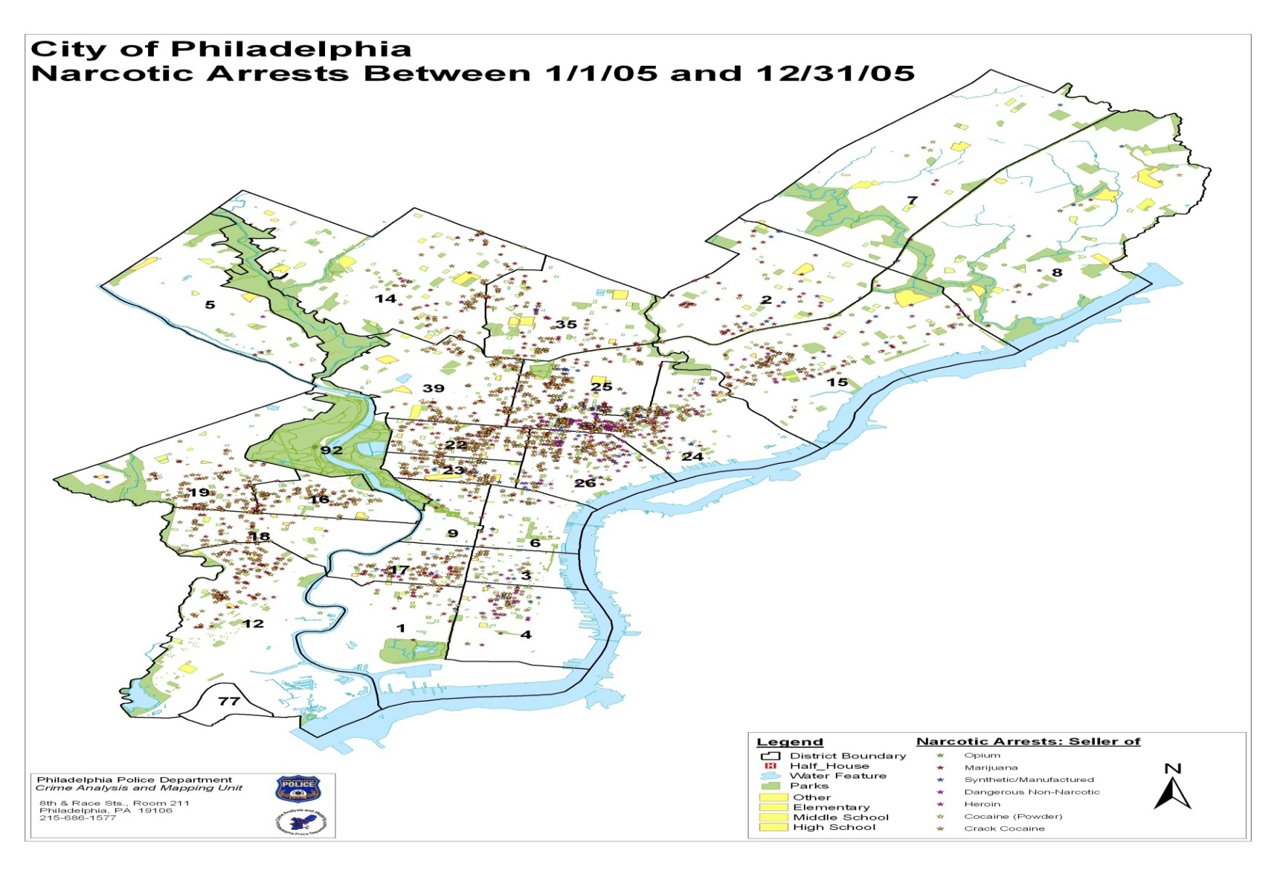
Rational For Transformation
Office of Addiction Services

Slide 27
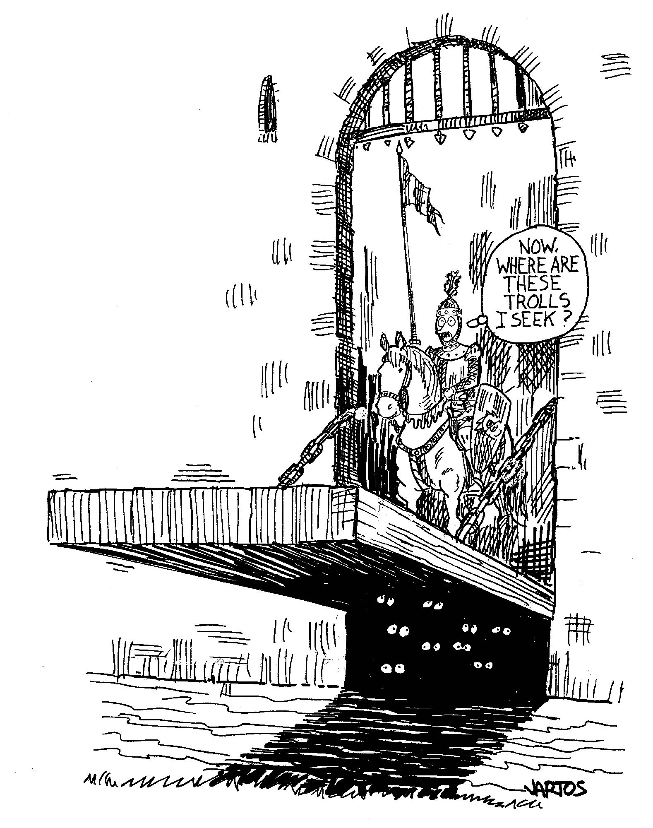
Stigma Driven Care
In our traditional systems of care we seek to cure, rehabilitate, rid people of their problems as we have assessed them.

Slide 28
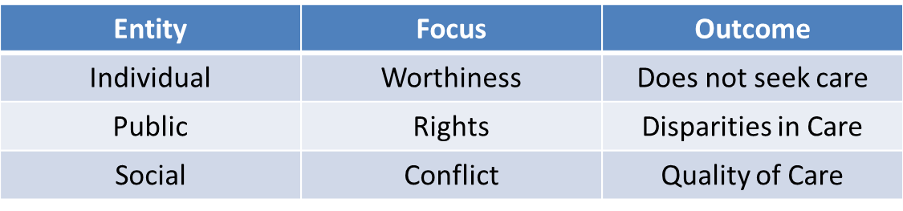
Impact of Stigma

Slide 29
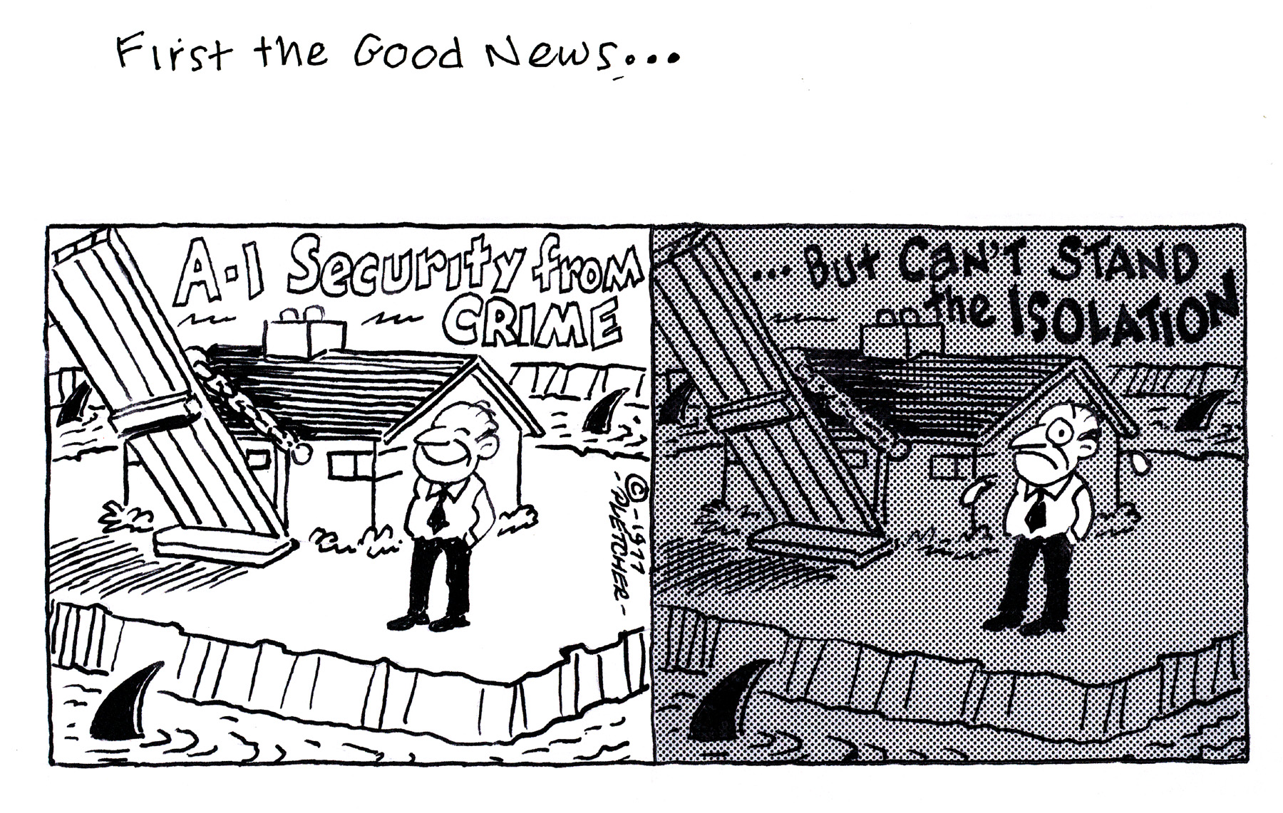
We hold these truths to be self-evident, that all are created equal,
Perception vs. Reality
Fix the client and send them home
But estranged from recovery supports

Slide 30
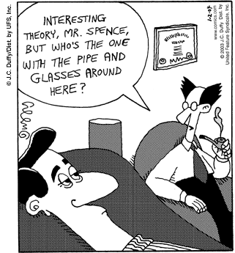

Slide 31

Surviving Addiction
The traditional umbrella of services and supports that are our systems of care are often fragmented and inaccessible.
In many ways when we are seen to be broken we cease to be seen as a person

Slide 32
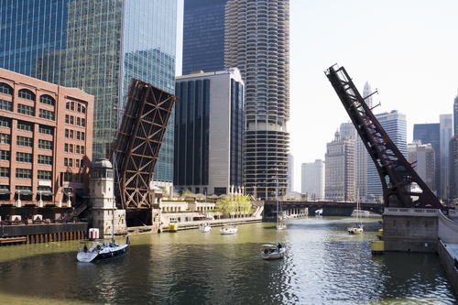
Traditional systems of care are like draw bridges constructed with the bridge up
Disconnects between:
  long term recovery & treatment
  individual/family & professional
  community & care
  self help & service

Slide 33
THE STRUGGLE
22 million need treatment 3 million get it
TO USE
OR
NOT TO USE

Slide 34
The Struggle (Rethinking our use of resources)
Spending in an Acute Care Model
Notes:
34

Slide 35

Responding to warning signs
Disconnects Between Community Based Supports & Professional Treatment > Stigma Driven Deficit Based Care > High Rates Of Recidivism > The Effectiveness Of Treatment Questioned > Cultures Of Helping vs. Serving

Slide 36



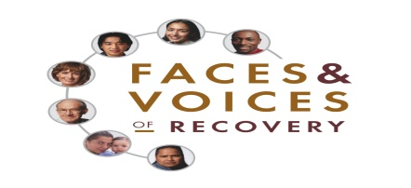
The goal for individuals with substance use disorders is long-term recovery from addiction, getting their lives back on track, improving their health, wellness and quality of life.
Systems that support recovery-based care provide individuals receiving care with a variety of services and options tailored to their specific needs to aid them in their process.
Multiple systems are engaged in coordination with traditional drug and alcohol treatment services. Some of these complementary services include education, housing, child care, financial planning, employment assistance, health care and legal assistance.
The person seeking help’s family and support network are also engaged in these various systems, frequently in the decision-making process.
Public policies are also in place to assist—not hinder—individuals seeking jobs, housing and education once they are no longer using alcohol or drugs.
Notes:
Just like the line in the road to guide how you drive we identified guides in creating recovery oriented systems, New Freedom Commission, SAMHSA, and……

Slide 37
Values of Recovery-Oriented Mental Health and Addictions Systems
The values of recovery-oriented mental health and addiction systems are based on the recognition that each person must either lead or be the central participant in his or her own recovery. All services need to be organized to support the developmental stages of this recovery process. Person-centered services that offer choice, honor each person’s potential for growth, focus on a person’s strengths, and attend to the overall health and wellness of a person with mental illness and/or addiction play a central role in a recovery-oriented system of care. These values can operate in all services for people in recovery from mental illness and/or addiction, regardless of the service type (i.e., treatment, peer support, family education).

Slide 38
(White, Boyle, & Loveland, 2002).
The drive to transform addiction treatment into a recovery oriented system of care includes substantial changes in clinical practices, including:
assertive approaches to early problem identification and engagement,
streamlined access,
global, continual, and strength-based assessment protocol,
a broadened multidisciplinary team that includes a primary care physician and peer-based recovery support specialists,
integration of evidence-based and culturally indigenous therapies,
greater use of home- and neighborhood-based services,
assertive linkage to communities of recovery and other indigenous recovery support resources,
sustained post-treatment monitoring, support, and, when needed, early re-intervention, and
a shift in focus from managing and evaluating self-encapsulated service episodes to management and evaluation of the long-term recovery process

Slide 39
Chameleons
Change

Slide 41




What It Means To Transform
From the New Life represented in the Egg, to the growth of the Caterpillar, to the Transformation within the Chrysalis, to the rebirth that is the Butterfly we appreciate little of the process if we don’t understand the relationship each stage has to the next and owes to those before it.
System Transformation requires that we appreciate each stage regardless how slow, painful and unpredictable, trusting that the end product is the foundation for a Community of Recovery.

Slide 42
System Transformation
Key steps in Philadelphia’s addiction treatment system transformation efforts include:
establishment of a Recovery Advisory Committee,
articulation of a clear vision (create an integrated behavioral health care system for the citizens of Philadelphia that promotes long-term recovery, resiliency, self-determination, and a meaningful life in the community),
identification of core values that would drive the system transformation process (hope; choice; empowerment; peer culture, support, and leadership; partnership; community inclusion/opportunities; spirituality; family inclusion and leadership; and a holistic/wellness approach),
a shift in the relationships between service practitioners and service consumers and between DBHIDS and its local service providers from authority-based relationships to relationships based on mutual respect and collaboration,
a highly participatory planning process that established a system transformation blueprint,
the use of training and technical assistance to orient people at all levels of the system to the recovery-focused transformation process, and
evaluation and ongoing refinement of funding and regulatory policies to eliminate obstacles to system transformation and reward innovation in service design.

Slide 43
PHASE ONE
Major Focus – Conceptual Alignment
Development of Philadelphia Recovery Definition
Guiding Values and Principles Identified by RAC
Numerous Conferences
Prevention and Day Transformation RFIs
Recovery Foundations Training
First Fridays Series
Transformation Documents

Slide 44
Voices of People in Recovery
How Do You Understand Recovery?
        To overcome, have a new life
        Setting life goals, education, gym, learning to drive
        Achieving independence from the system
        Living a normal life
        Finding people and groups that support me

Slide 45
Voices of People in Recovery
What would help in your recovery?
  More Respect
  It seems that the system is all about money and dx, not the person – we could change this
  Opportunities to give back
  Providers who see that my problems are only a part of me
  Peer led support groups, and staff who are people in recovery and who know the community
  Different kinds of groups that fit different people

Slide 46
Voices of People in Recovery
What would help in your recovery?
        Increased focus on spirituality
        Increased family involvement in my recovery
        Need administrators to understand what it’s really like to be us…what the people at the top see as success is not what we see as success…
        I want my life back….

Slide 47
Recovery Asset Baseline Assessment Objectives:
Identification of existing strengths
Measurement of baseline recovery orientation
Development of new channels of feedback between community at large and DBH/MRS
Providing agency specific feedback for their individual development.

Slide 48
Recovery Asset Baseline Assessment: Challenges
Are top system leaders really invested in the transformation?
Will creativity/risk taking be rewarded or punished?
Is there an inherent conflict between the system transformation vision and managed care priorities?
Will communication open up to flow both ways and will input from those outside DBH/MRS be taken seriously?
Will providers create meaningful leadership roles for people in recovery?

Slide 49
Recovery Asset Baseline Assessment: Challenges
  Will the barriers that prevent people from moving into, within and out of the system be removed?
  Will disparities in location and availability of services be addressed?
  Will there be creative ways to fund additional training, technical assistance and increased salaries for direct care workers?
  Will the monitoring/credentialing/care management functions line up with the recovery vision?

Slide 50
Recovery Asset Baseline Assessment: Findings--Strengths
The system is ready for change.
There is already evidence of increased transparency and partnering in decision making.
Individual agencies are already developing recovery oriented services and appreciate increased opportunities to share successes with transformation.
Increased interest in and movement toward including people in recovery as active members of teams in planning and directing services.
Enthusiastic community of people in recovery who want to support the transformation

Slide 51
Philadelphia Recovery Perspective
Recovery is the process of pursuing a fulfilling and contributing life regardless of the difficulties one has faced. It involves not only the restoration but continued enhancement of a positive identity and personally meaningful connections and roles in ones community. Recovery is facilitated by relationships and environments that provide hope, empowerment, choices and opportunities that promote people reaching their full potential as individuals and community members. Do we only recognize the State of Recovery or do we acknowledge the struggle of those to overcome the challenges of people, places, and things that ultimately lead to the neurobiological condition we call addiction. Is there a place before the State of Recovery that we outreach engage and enlist for recovery?
  Preamble to Philadelphia’s Practice Guidelines

Slide 52

Philly Approach to ROSC
Recovery As An Umbrella Concept

Slide 53

Recovery is the Umbrella under which everything fits
Shedding the bifurcation of Recovery and Treatment
Supporting the Empowerment of those in Recovery to direct recovery and treatment services

Slide 54

Recovery Perspectives
Recovery refers to the ways in which persons with or impacted by a mental illness and/or addiction experience actively manage the disorders and their residual effects in the process of reclaiming full, meaningful lives in the community.
■ Recovery-oriented care is what psychiatric and addiction treatment and rehabilitation practitioners offer in support of the person’s own long-term recovery efforts.
  Recovery as an Organizing Principle for Integrating Mental Health and Addiction Services; Larry Davidson PhD Yale University

Slide 55

Guiding Values and Principles
Hope: People can and do recover. Change is always possible, and the extent of change is often beyond what we can imagine. Hope is nurtured by seeing and hearing others living meaningful lives in recovery and giving back to their families and communities.

Slide 56

Guiding Values and Principles
Choice: Each person’s opinions, wants, needs and individual recovery pathway are respected and elevated above all other considerations. Services are individualized and built around the person rather than fitting the person to a “program.” . There is recognition by all parties in the system that there are many pathways and styles of recovery and that clients have a right to choose a personal pathways and style of recovery.

Slide 57



Slide 58

Guiding Values and Principles
Self-direction/empowerment: People in recovery lead their personal path of recovery. They do this by optimizing autonomy and exercising independence and choice. The individual identifies personal life goals and in collaboration with others, directs his or her recovery by designing a unique path towards those goals. People have the opportunity to choose from a range of options and to participate in all decisions that affect their lives.

Slide 59

Guiding Values and Principles
Peer culture/Peer support:
There is recognition of the power of peer support within communities of recovery as reflecting in, : 1) hiring persons in recovery into Certified Peer Specialists and other positions, 2) assuring representation of people in recovery at all levels of the system

Slide 60
Peer culture/Peer support cont:
3) forging collaborative relationships between treatment institutions and the service structures of local recovery mutual aid societies, 4) assertively linking people to peer based recovery support services (i.e. mutual self help groups, informal peer support etc.), and 5) acknowledging the role experiential learning within a community of recovery can play in initiating and sustaining a recovery process.

Slide 61

Guiding Values and Principles
Consumer Leadership: People in recovery have active leadership roles at all levels of the system.

Slide 62

Guiding Values and Principles
Partnership: Relationships of all parties within the behavioral health care system are based on mutual respect; service designs shift from an expert model to a partnership/consultation model where everyone’s perspective, experience and expertise is welcomed and considered.

Slide 63

Guiding Values and Principles
Community integration/opportunities: The focus is on nesting recovery in the person’s natural environment, integrating the individuals/families in recovery into the larger life of the community, tapping the support and hospitality of the larger community, developing

Slide 64

Guiding Values and Principles
Spirituality: Belief in the “God of one’s own choosing” is seen as a potentially valuable resource for recovery support and is respected as a chosen component of an individual’s recovery support system. There is respect for explicitly religious, spiritual and secular pathways of recovery.

Slide 65
Understanding Supports
Fetzer Institute, National Institute on Aging Working Group (1999). Multidimensional measurement of religiousness/spirituality for use in health research. A report of a national working group supported by the Fetzer institute in collaboration with the national institute on aging Kalamazoo, MI: Fetzer Institute.
Religiousness has specific behavioral, social, doctrinal, and denominational characteristics because it involves a system of worship and doctrine that is shared within a group.
Spirituality is concerned with the transcendent, addressing ultimate questions about life’s meaning, with the assumption that there is more to life than what we see or fully understand. (…) While religions aim to foster and nourish the spiritual life–and spirituality is often a salient aspect of religious participation–it is possible to adopt the outward forms of religious worship and doctrine without having a strong relationship to the transcendent.

Slide 66

Guiding Values and Principles
Family inclusion: Family members are actively engaged and involved at all levels of the service process. Families are seen as an integral part of the team of support with their input valued and respected.

Slide 67

Guiding Values and Principles
Holistic and wellness approach: Services are designed to enhance the development of the whole person; care transcends a narrow focus on symptom reduction and promotes wellness as a key component of all treatment and support services.

Slide 68
Challenge
Significantly improving long-term recovery outcomes will require a radical reengineering of addiction treatment as a system of care. Rather than system refinement, they are advocating a “fundamental shift in thinking”, a “paradigm shift”, a “fundamental redesign”, “a seismic shift rather than a mere tinkering”, and a “sea change in the culture of addiction service delivery”.
Bill White ATTC Draft

Slide 69
The Philadelphia Recovery Oriented System of Care
Promotes Community Integration and Builds Recovery Capital in the Community
Facilitates a Culture of Peer Support and Leadership and Family Inclusion
Values Partnership and Transparency
Provides Individualized, Holistic, Person Directed Treatment
Driven by Outcome Data, Evidence Based Practices and the Experiences of People in Recovery
Creates Mechanisms for Sustained Support (Evans, 2009)

Slide 70
PHASE TWO
Major Focus – Practice + Contextual Alignment
Identification of Priority areas through the recovery assessment process and the RAC
    Community inclusion/opportunity
    Holistic Care
    Peer culture/peer support/peer leadership
    Family inclusion and leadership
    Partnership
    Extended recovery support
    Quality of care

Slide 71
Notes:
71

Slide 72
Phase II:
Implement initial practice priorities, reorient DBHIDS practices, identify areas in need of regulatory relief, increase leadership of people in recovery, increase community support

Slide 73
PHASE TWO
DBH/MRS Internal Practice Alignment
  Alignment, Coordination and Integration of Insured, un/underinsured services
  Unit Recovery Plans
  Reconfigure existing services (e.g. Day transformation, addictions services..)
  Hiring of people in recovery and family members as consultants
  Systems Relationships
  Internal Restructuring/ Internal Accountability

Slide 74
PHASE TWO
Aligning practices with a recovery orientation will impact the following domains:
  Service Engagement
  Service Access
  Recovering Person’s Role
  Service Relationship
  Assessment and Clinical Care
  Locus of Service Delivery
  Post Treatment Checkups and Supports
  Relationship to Community

Slide 75
PHASE TWO
In order to support practice alignment in the provider community, DBH/MRS will:
  Provide Advanced Recovery Trainings
  Offer Train the Trainers Trainings
  Distribute Resource Packets
  Support Demonstration Projects
  Offer Site Based Technical Assistance
  Host Community forums
  Enhance organizational capacity through the development of change management teams
  Provide incentives for innovation and alignment

Slide 76
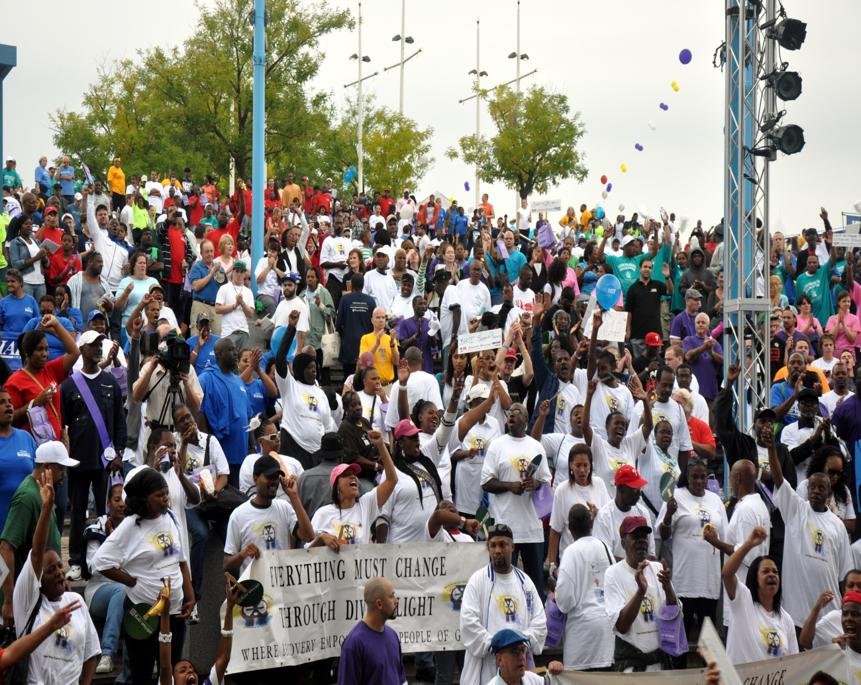
Philly Recovery Walk 2011
15,000

Slide 77
PHASE TWO
DBH/MRS Context Alignment
  Strengthening Partnerships with sister agencies, DHS, prisons, schools, etc..
  Developing new partnerships with organizations that provide vocational, educational and housing services
  Active Partnership and advocacy with OMHSAS on day transformation
  Advocacy with our SSA regarding co-occurring services
  Developing financing mechanisms for peer specialists in D&A programs
  Identification of additional areas of regulatory relief needed to support the advancement of our priorities

Slide 78
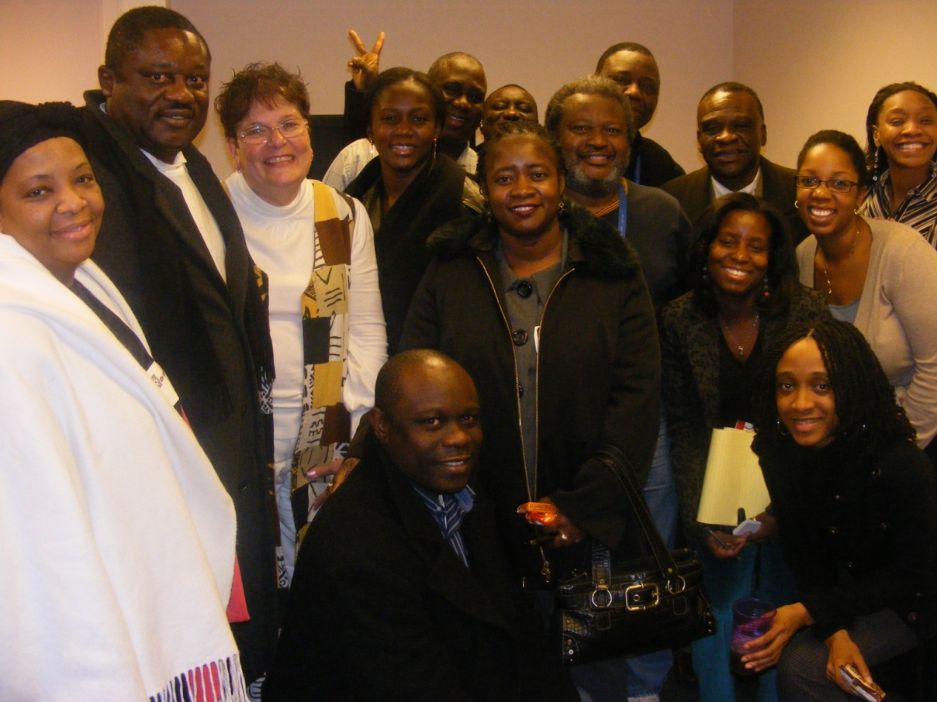
Philly DBHIDS believes that collaboration and partnerships make us strong….African Caribbean Task Force

Slide 79
PHASE TWO
DBH/MRS Context Alignment
Anti Stigma Media Campaign
Increased Community Education (e.g. faith based Initiative)
Collaborative relationships with Political Leaders
Stronger connections between formal and informal treatment supports
Increased collaboration between physical and behavioral health

Slide 80
Are Recovery Oriented Systems Driving
Orientation to quality of life and symptoms
Capacity to individualize interventions
Discharge planning with emphases on peer and natural supports
Moving from diagnostically oriented tracks to fully integrated supports
Supervision models to build hope and to focus on recovery
Increased visibility of people in recovery and alumni as mentors and bridgers to community
          A Vision for a Recovery Framework in Behavioral Health Systems: Smith and Mathai; New York Association of Psychiatric Rehabilitation Services

Slide 81

creating ways in which to reduce stigma
Mural Arts: Personal Renaissance

Slide 82
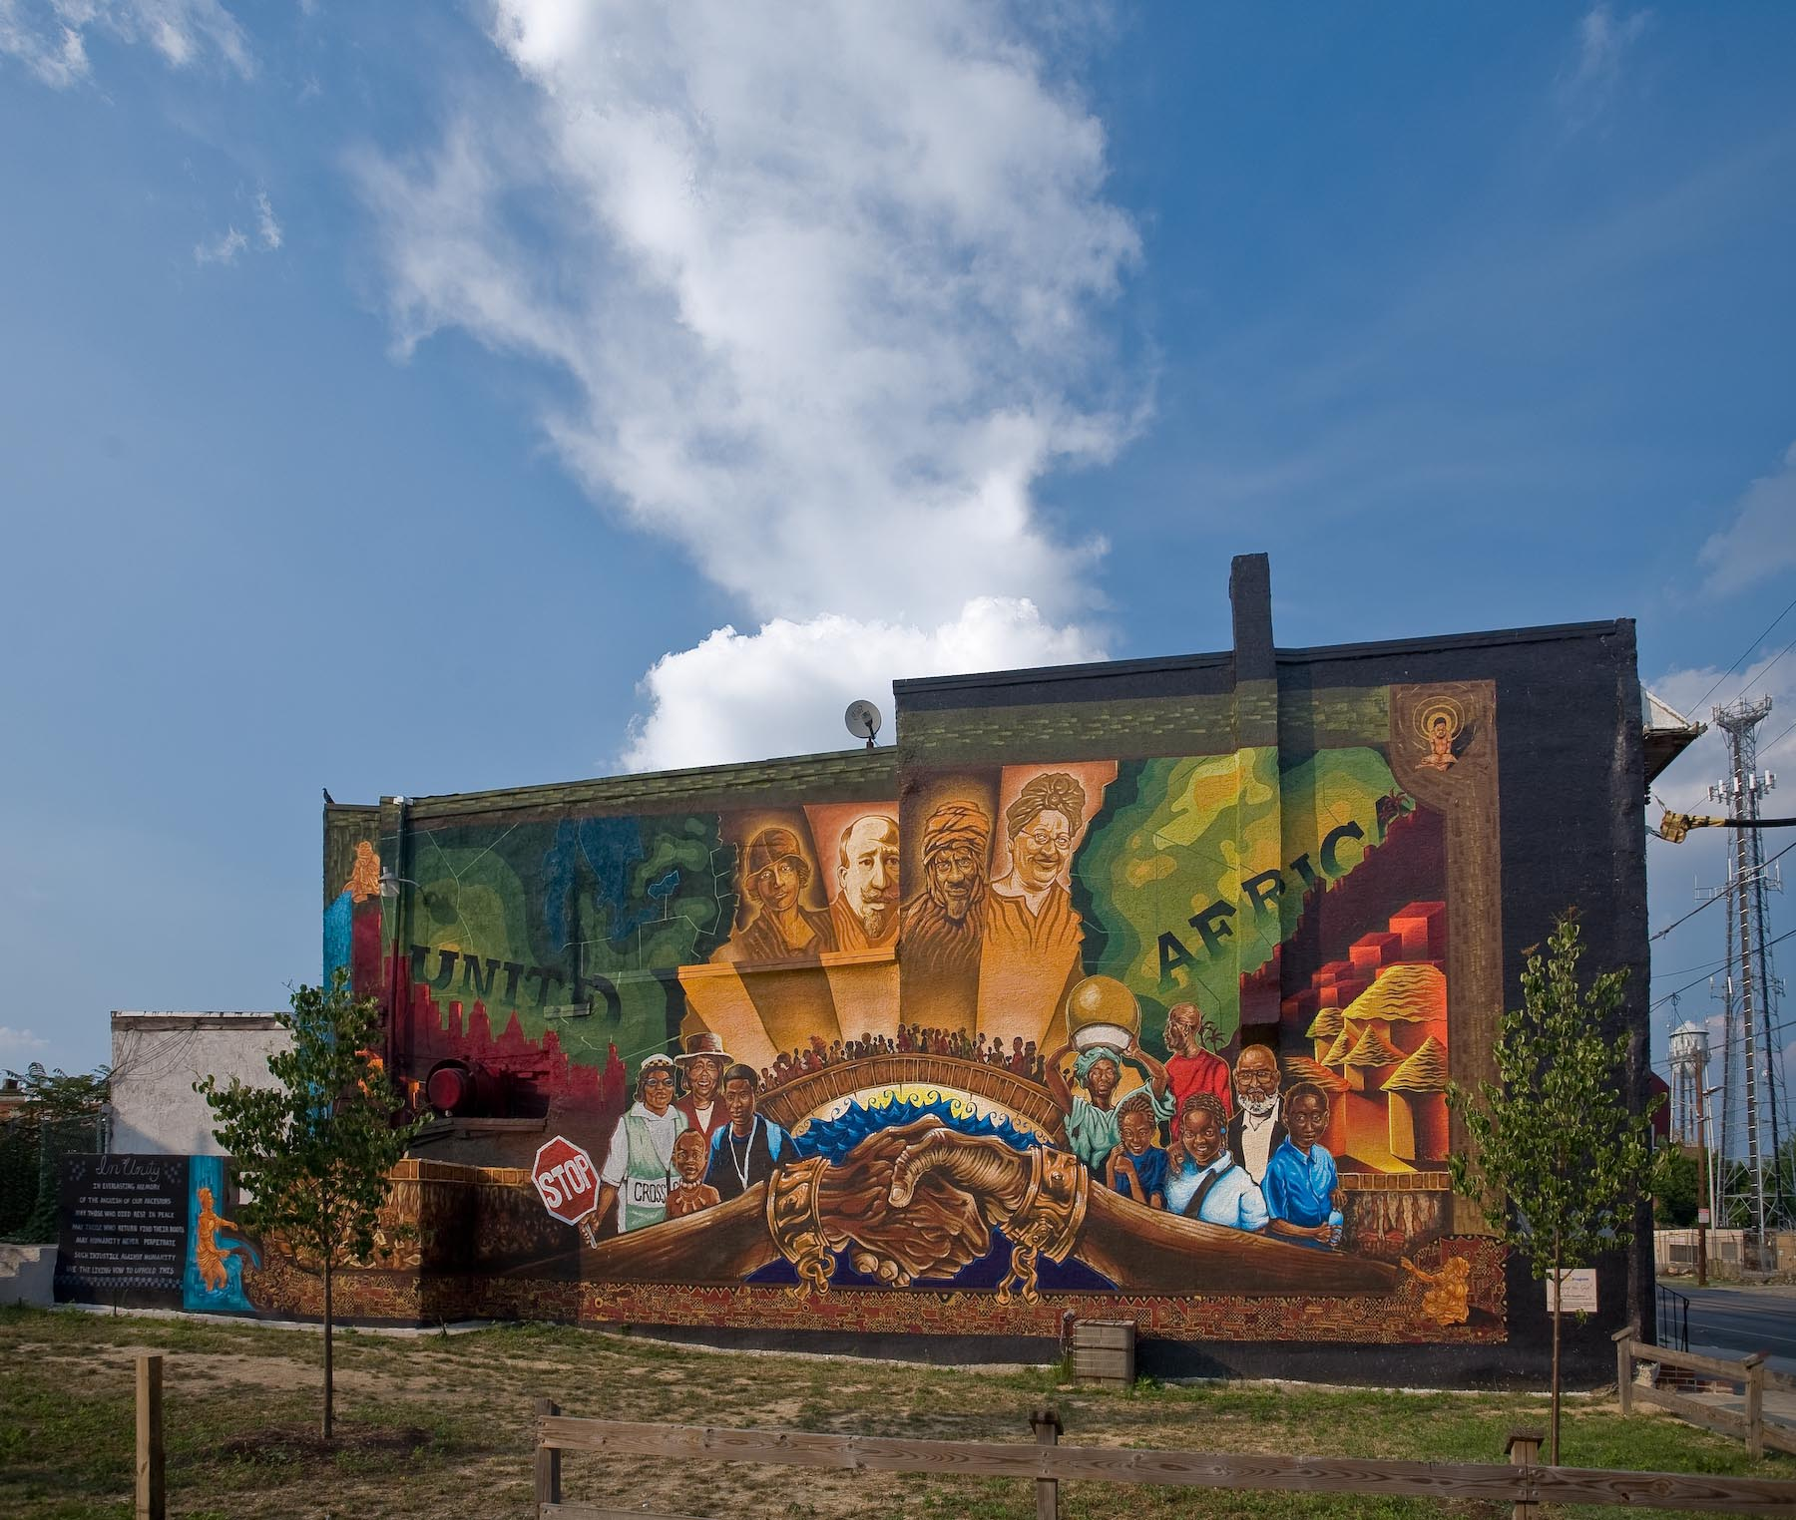
Informing our work with the community-at-large at all levels Mural Arts: Bridging the Gap

Slide 83
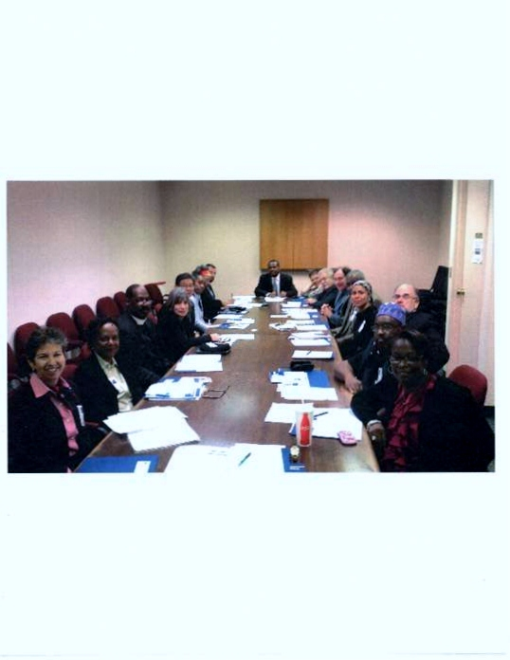
Building bridges into the community
DBHIDS Faith & Spiritual Affairs Advisory Board

Slide 84
Notes:
84

Slide 85
Integration Of Transformation
Phase III:
Use evaluation data to modify priorities, enhance recovery oriented practices at DBH/MRS and providers based on lessons learned, develop models of recovery oriented practices, obtain broader community support, increase advocacy based on successes within the system and identified barriers, introduce Practice Guidelines
Phase IV:
Utilize the feedback cycle and evaluation data to continue enhancing the system, focus on developing a data driven system of care

Slide 86
Giving Context to Practice
DBH/MRS: Recovery Definition
Practice Guidelines
The practices outlined in this document are intended to guide providers as they strive to implement services and supports that promote recovery and resilience. It is clear that this document does not yet totally represent the system as it is but sets a vision and clear direction for practice in the system that is emerging and will continue to evolve. This document serves as the foundation document for the development of other guidelines that are more specific in terms of level of care requirements, credentialing etc. In order for these practices to become fully integrated into the system, however, there will need to be significant changes in the fiscal, policy, regulatory, and community contexts. As a result, while this document focuses on practices that need to occur in service and support settings, two additional documents will be developed which will detail the changes that will need to occur in other settings
Recovery is the process of pursuing a fulfilling and contributing life regardless of the difficulties one has faced. It involves not only the restoration but continued enhancement of a positive identity and personally meaningful connections and roles in ones community. Recovery is facilitated by relationships and environments that provide hope, empowerment, choices and opportunities that promote people reaching their full potential as individuals and community members.

Slide 87
Clinical Services: Screening, Assessment, Planning and Delivery
Ensuring providers are conducting:
  Screening/Identification of people at risk, or who are in the early stages of a behavioral health challenge
  Assessments of the Whole Person process leading to an exploration of the full breadth of a person’s life situation as well as clinical, developmental, and health challenges,

Slide 88
Assertive Outreach, Engagement & Retention:
How we support Providers and in turn how they support Assertively Outreaching, Engaging & Retaining those in need and seeking treatment by
Ensuring that providers are Outreaching to those in need.
Ensuring providers are Engaging those seeking treatment.
Ensuring providers have in place practices central to retaining them in treatment and sustaining recovery.
Ensuring providers are assisting those in care in their communities and them as to how they contributes to community health.

Slide 89
Community Connection and Mobilization:
How do we support provider’s Executive And Administrative Strategies For Creating A Culture That Supports Community Connections
Ensuring providers are committed to supporting people in moving beyond their problems and challenges to developing a full and meaningful life in the community.
Ensuring providers recognize they can and must have strong connections to the communities in which they are located.

Slide 90
CONTINUING SUPPORT AND EARLY RE-INTERVENTION
How do we support providers practicing Continuing support and early re-intervention as critical components of behavioral healthcare.
Ensuring providers have a diverse array of strategies designed to provide continuing support spanning very different types of assistance, provided by professionals, peers, and community-based allies.

Slide 91
Be Inclusive of those in recovery and their families
Value the experience of those in recovery.
Respect their culture of recovery whatever it may be
Treat all family members of those in recovery, their community as partners.
Reach out to other system/institutional stakeholders invested in those you serve.
Offer to help those in recovery direct their recovery.
Be responsible with property and belongings.

Slide 92

What’s Your Direction?

Slide 93
Traditional vs Recovery
Oriented view of Peer Participation
TRADITIONAL | RECOVERY ORIENTED
Peers seen as an adjunct | Peers seen by leaders as critical to the success of the system
Role of Peers defined by and limited to 12-step programs | Role is critical element of a system that creates options and provides appropriate support
Ethical Issues viewed through the lens of the treatment professional | Ethical issues are raised purely within the work of the peers
Peers separate from the treatment process | Treatment Professionals and peers partner for the good of those seeking recovery
Anonymity Promoted (hallmark) | Putting a face on recovery
Notes:
93

Slide 94
Knowing Where Your System is Re: Transformation
Stage of Readiness for Transformation | Activities of the Recovery Community
Pre-Contemplative | Motivate system leaders to initiate change
Contemplative | Help shape the change process. Ensure that Peer Support Services are an integral part of the plan
Action | Propose Peer Support Services and advocate for support. Help design services that meet system needs
Sustain Change | Thank God you are in a Progressive system!
Notes:
94
How to Evaluate Where Your System Is In Transformation
What is Your Role in Your System at Home

Slide 95
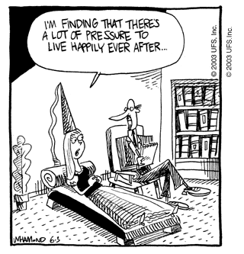
Notes:
95
The Recovery Movement has helped a lot of people with behavioral health issues see that there is a possibility for a better life. However, sometimes other people in recovery or even professionals may put pressure on a person to experience their recovery in a certain way. It’s important that while you have experienced recovery in your own life, how another person experiences that or what they want for their life may still be very different than what you have chosen in your life. A good supportive peer specialist will help that person find what’s important to them rather than try to pressure them into being a certain way. We all have a different path in recovery. That is what makes it such an exciting and unique experience.
As administrators and people who are concerned with the quality of the services we are funding, we are very aware that some of the outcomes we can demand of providers can inadvertently put pressure on people in recovery to be a certain way. So, we have to be really careful to listen to people in recovery and have them involved in developing what standards providers should be held to. As a peer specialist, you also have an opportunity to encourage other people in recovery to step forward and be a part of that process either by sitting on advisory boards and filling out surveys that determine if services are meeting their needs.

Slide 96
What is required in order for a person to have access to effective treatments and supports that facilitate living working, learning, and full community integrations?
A Service Delivery System that is embedded in the larger social context.

Slide 97
Principles of Recovery
Person-driven;
Occurs via many pathways;
Is holistic;
Is supported by peers;
Is supported through relationships;
Is culturally-based and influenced;
Is supported by addressing trauma;
Involves individual, family, and community strengths and responsibility;
Is based on respect; and
Emerges from hope.

Slide 98
Encouraging Citizens of Recovery to:
  Participate in recovery focused training
  Read on recovery topics, research and practice topics
  Volunteer to participate in on-going work groups
  Host opportunities for people in recovery to share their stories with agency staff and others
  Participate in Community Forums
  Request a system transformation presentation from the Speakers Bureau
  Share your successes, struggles and concerns so that we may learn from one another

Slide 99
Philadelphia Description
1,526,006 Population (2010)
53.2 % Female
43.4 % Black only 41.0 % White only
6.3 % Asian only 6.5 % Other Race only
2.8 % Two or more races 12.3 % Hispanic ethnicity (any race)
-----------------------------------------
11.4 % of adults in Philadelphia are in recovery (n = approximately 128,300).
-----------------------------------------
Philadelphia Density = 9,999.9 per square mile (Pennsylvania density = 283.4 per square mile)
-----------------------------------------
Philadelphia “in facility” prison census: adults = 7,750, juveniles = 53 (as of August 23, 2011)
SOURCES: U.S Census Bureau, American Community Survey; Public Health Management Corporation – Community Health Data Base; Philadelphia Prison System

Slide 100
Prevalence survey: dependence or abuse in the past year, age 12 and older
SAMHSA, NSDUH - 2006, 2007, 2008 combined | Philadelphia | Pennsylvania | Total U.S.
illicit drug dependence or abuse | 3.27 % (n=42,440) | 2.27 % | 2.82 %
alcohol dependence or abuse | 6.71 % (n=87,087) | 6.32 % | 7.53 %
illicit drug or alcohol dependence or abuse | 8.88 % (n=115,251) | 7.64 % | 9.07 %
Source: SAMHSA, NSDUH - 2006, 2007, 2008 combined

Slide 101
Prevalence survey: dependence or abuse in the past year, age 12 and older
2004 -2005-2006
Samhsa/OAS/NSDUH
SAMHSA, NSDUH - 2006, 2007, 2008 combined
 | Phila. | PA | Total US
illicit drug dependence or abuse | 3.39 | 2.56 | 2.91
alcohol dependence or abuse | 7.77 | 7.13 | 7.79
illicit drug or alcohol dependence or abuse | 9.78 | 8.52 | 9.24
 | Phila. | PA | Total U.S.
illicit drug dependence or abuse | 3.27 % | 2.27 % | 2.82 %
alcohol dependence or abuse | 6.71 % | 6.32 % | 7.53 %
illicit drug or alcohol dependence or abuse | 8.88 % | 7.64 % | 9.07 %

Slide 102
Number of deaths with the presence of any drug and number of cases with at least one illicit drug detected,** in Philadelphia: 2004 to 2010
% w/illicits 45.3 61.7 65.5 58.5 52.6 47.9 45.2
‘04 ‘05 ‘06 ‘07 ‘08 ‘09 ‘10
** Illicit drugs include cocaine, heroin, PCP, methamphetamine, MDA, and MDMA.
SOURCE: Philadelphia Medical Examiner’s Office

Slide 103
Number of deaths with the presence of any drug in Philadelphia: 2004 to 2010
‘04 ‘05 ‘06 ‘07 ‘08 ‘09 ‘10
SOURCE: Philadelphia Medical Examiner’s Office

Slide 105
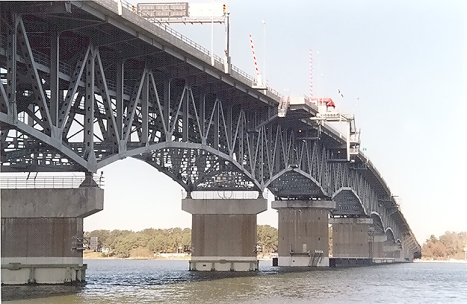
Rebuilding the Draw Bridge
Reconnecting:
  Long Term Recovery & Treatment
  Individual/Family & Professional Relationships
  Community & Agency
  Self Help & Clinical Services

Slide 106

Integrating
Peer Support Services onto Systems of Care

Slide 107
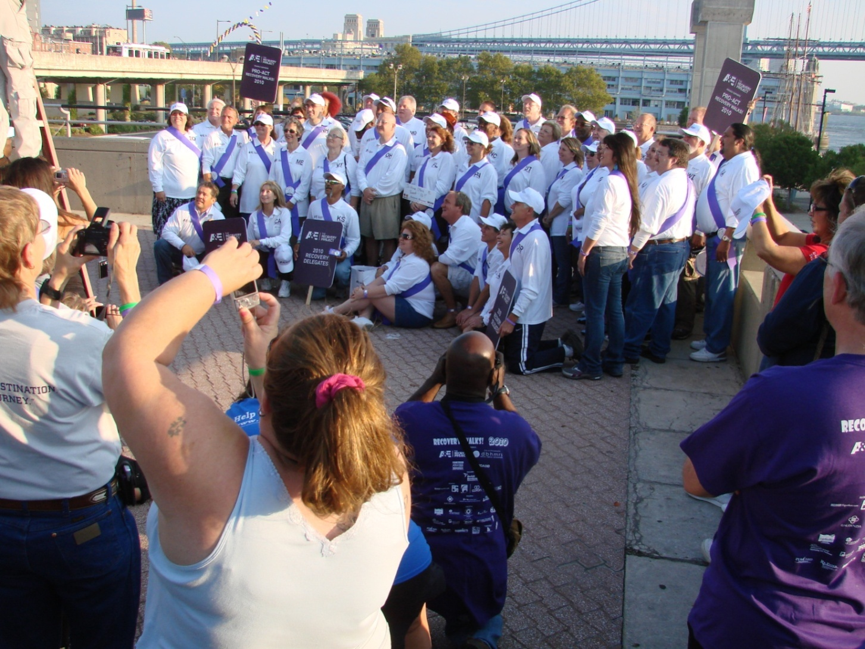
Peers of Renown

Slide 108
Building Pathways
The Role of Peers
What do peers bring that is unique:
  Wisdom – been there and know the path
  Compassion – emotional support
  Approachability – don’t look at people from a clinical perspective but rather as people like themselves
  Flexibility to people’s needs – sometimes provision
Potential disadvantages:
  Ethical issues – drawing the lines
  Knowing the limits of abilities
  Landscape changing without recognizing it
Notes:
108

Slide 109
What is peer support?
  Peer support is social and/or emotional support (frequently coupled with material support)- provided by persons who have psychiatric and addiction challenges to others who have similar conditions. The goal is to bring about a desired social or personal change.
  Peer support were once generally thought of as being provided through both one-to-one connections and self-help groups.
        Self-help groups are defined as voluntary small group structures for mutual aid in the accomplishment of a specific purpose. Generally, these groups are formed by peers who get together to satisfy a specific need, overcome a specific problem, and/or bring about personal or social change.
    .

Slide 110
What are peer-delivered services?
    However, there is an expanded definition of peer support, which includes one-to-one counseling (peer-to-peer), and peer-run or peer-operated services (including residential and vocational programming).
Peer-delivered services are services provided by individuals who identify themselves as having mental illnesses, are receiving or have received mental health services for their mental illnesses, and deliver services for the primary purpose of helping others with mental illnesses.
  Peer-delivered services may also include partnering with non-peers, but peers still maintain control of the service. These may be called peer-partnership services.
  Peer-run or -operated services are services that are planned, operated, managed by people with psychiatric disorders.
  •Examples of peer-run services are drop-in centers, crisis services, and employment services.
  Peer employees are individuals who identify as peers and are hired by non-peer agencies, e.g., community mental health centers. Peers may be hired into designated peer positions or traditional clinical positions.
  Peers serve as case managers, outreach workers, and mobile crisis workers, among other possibilities.

Slide 111
Type of Social Support and Associated Peer Recovery Support Services
Type of Support | Description | Peer Support Service Examples
Emotional | Demonstrate empathy, caring, or concern to bolster person’s self-esteem and confidence. | Peer mentoring Peer-led support groups
Informational | Share knowledge and information and/or provide life or vocational skills training. | Parenting class Job readiness training Wellness seminar
Instrumental | Provide concrete assistance to help others accomplish tasks. | Child care Transportation Help accessing community health and social services
Affiliational | Facilitate contacts with other people to promote learning of social and recreational skills, create community, and acquire a sense of belonging. | Recovery centers Sports league participation Alcohol- and drug-free socialization opportunities
Center for Substance Abuse Treatment, What are Peer Recovery Support Services? HHS Publication No. (SMA) 09-4454. Rockville, MD: Substance Abuse and Mental Health Services Administration, U.S. Department of Health and Human Services, 2009.

Slide 112
Philadelphia’s Peer Initiative
Joint work with the Mental Health Peer organization
        Developing a “behavioral health” peer specialist model, pilot training 100 across system for now
Putting a Face on Recovery
Telephonic Aftercare
Medicaid reimbursement
Credentialing peer run providers
All funding decisions for new programs include determining if a program is committed to peer work
Evolving roles within the DBHIDS
Implementing Bill White’s 16 Principles of Recovery Management
Notes:
112

Slide 113
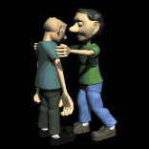
Roles are defined by who?
Sometimes the role is misunderstood by the peer, the employer, as well as those receiving services

Slide 114
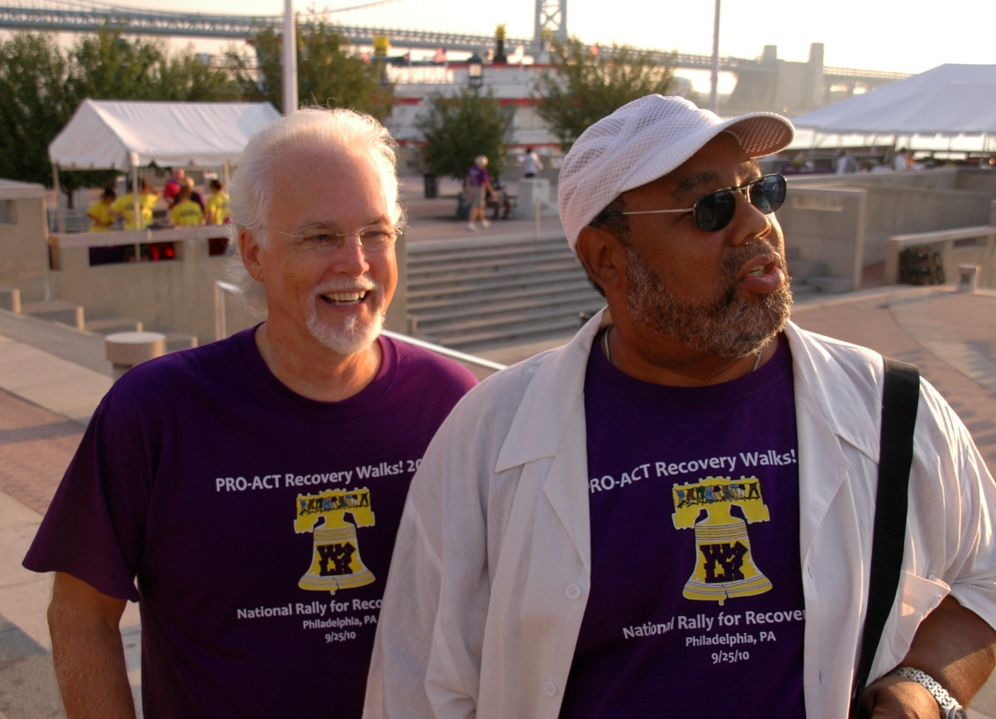
Peers of All Shapes and Sizes

Slide 115
Peers As Prosumers vs. Professionals
From the work of Bill White
As Peers in the context of a Recovery Oriented System of Care their role is not to be the:
Professional Clinician
Default disciplinarian
Saviour

Slide 116
Rationale P-BRSS in the addictions arena are based on the following propositions:
• Helpers derive significant therapeutic benefit from the process of assisting others
(the “helper principle”) (Reisman, 1965, 1990; recovery slogan: “To get it, you
have to give it away.”).
People who have overcome adversity can develop special sensitivities and skills in helping others experiencing the same adversity--a “wounded healer” tradition that has deep historical roots in religious and moral reformation movements and is the foundation of modern mutual aid movements.

Slide 117
The inadequacy of acute care models of treatment for people with high problem severity and complexity is evident in low engagement rates, high attrition rates during treatment, low aftercare participation, and high re-admission rates.6
Persons with high personal vulnerability (family history, low age of onset of use, traumatic victimization), AOD problem severity and complexity (co-morbidity) and low “recovery capital”7 do not fare well in acute models of intervention but can achieve recovery when provided sustained support. (P-BRSS constitute an essential element within new models of sustained recovery management) (White,
Boyle and Loveland, 2002, 2003).8

Slide 118
• Many addicted people benefit from a personal “guide” who facilitates
disengagement from the culture of addiction and engagement in a culture of
recovery (White, 1996).
• Peer-based recovery support relationships that are natural, reciprocal, and
enduring are not mutually exclusive of, but qualitatively superior to, relationships
that are hierarchical, commercialized and transient.
• P-BRSS are an attempt to re-link treatment and recovery (Else, 1999; White,
2000b), to move the locus of treatment from the treatment institution into the
natural environment of those seeking treatment services (White, 2002a), and to
facilitate the shift from toxic drug dependencies to “prodependence on peers”
(Nealon-Woods, et al, 1995).

Slide 119
P-BRSS services are congruent with research findings that:
• Addiction recovery begins prior to the cessation of drug use; is marked in its earliest stages by extreme ambivalence; is sustained long after the period of initial stabilization of sobriety; involves different types of age-, gender-, and culture-mediated
change processes; and is often marked by predictable stages of change.
• The achievement of stable recovery is determined, in part, by recovery capital that can be enriched through support services.
• Factors that sustain recovery are different than those that initiate recovery.
• Push factors (pain) and pull factors (hope) both play a role in the recovery process; P-BRSS have a direct effect on the latter.
.

Slide 120
How Peer Recovery Support Solves Problems with the System:
Increase Access
Increase Retention and Engagement
Increase Effectiveness: peers are great recovery guides
Increase support options
Notes:
120

Slide 121
What System Administrators Want from Peer Recovery Support Providers
Solve system problems
Partner on the Bigger Picture
Understanding of the issues and Advocacy
Diversity and Outreach to underserved groups
Notes:
121
See your activities and value beyond a discrete (while important) program.
Peer-Based service providers can and should make systems better because of their broader involvement.
We need you to help with the broader agenda of recovery, because discrete programs in the end will not be enough, nor will they be sustainable without a systemic approach

Slide 122
RESOURCES SUPPORTING RECOVERY
MEDICALLY
MANAGED
MEDICALLY
MONITORED
A CONTINUUM, OF RECOVERY
MEDICATED ASSISTED TXs.
TRANSITIONAL
INTENSIVE OUTPATIENT & OUTPATIENT
SELF HELP / COMMUNITY FOCUSED RECOVERY
Notes:
122

Slide 123
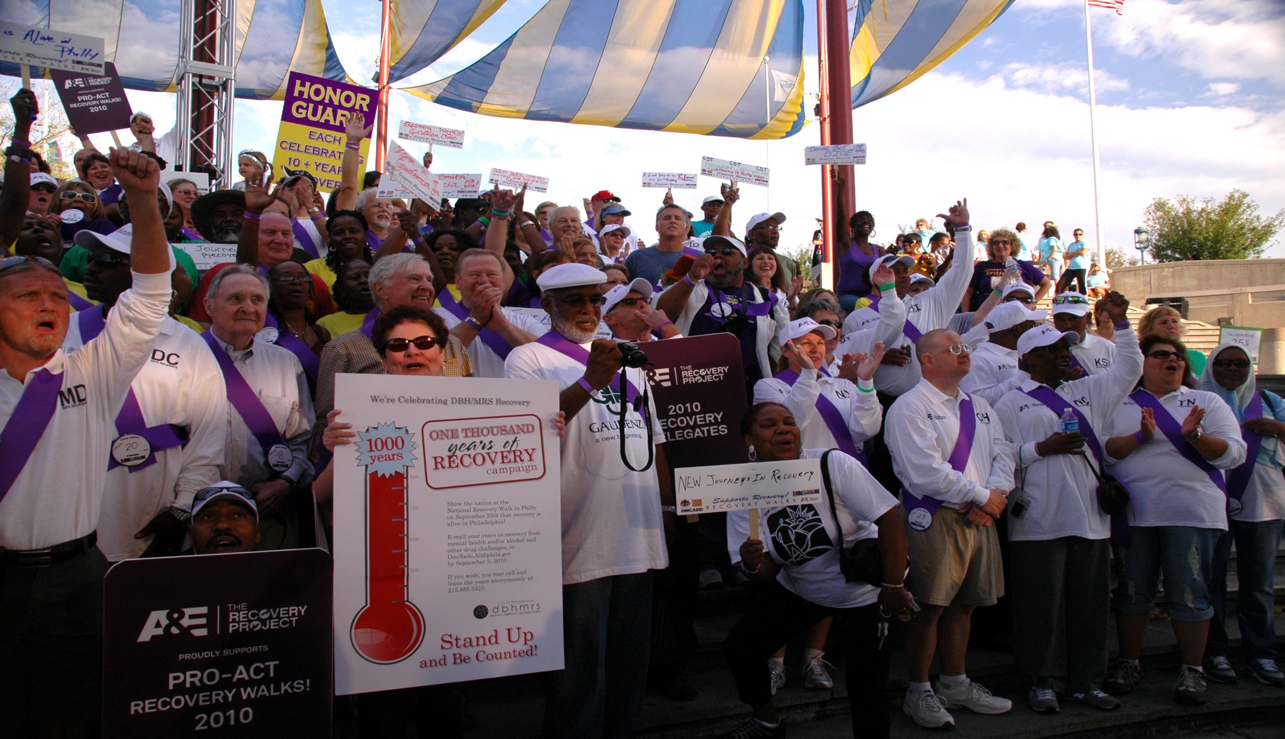
Recovery Begets Recovery

Slide 124
A view from an administrator
Characteristics of good Peer Recovery Support Providers:
Pursue Funding for sustainability
Push the envelope/be creative
Services based on volunteerism or if paid, the money does not corrupt the essence of peer based service
Learn the issues in the field
Put a face on recovery
Measure outcomes and demonstrate effectiveness
Tie into the broader agenda to increase relevance and collaboration
Notes:
124

Slide 125
Refocusing on Recovery
Key to this model of care is the evolution of a system of specialized community-based programs.
  As envisioned these programs would not be providers per se, but rather offer an environment that offer citizens the opportunity to articulate their problems and contemplate what possible steps might be taken to address these problems.
  These community centers would be an enduring presence in the lives of the individuals, serving as an entry point for accessing the system of care and as a point of return when treatment was completed.
  Long-term outreach and follow up would be expected of the community centers as well as ongoing contact during a treatment experience.
PHMC
PRO - ACT
NEW PATHWAYS
PHILADELPHIA RECOVERY
COMMUNITY CENTER
ONE DAY AT A
A TIME
Notes:
125

Slide 126
What is a Recovery Community Center (RCC)?
An RCC is a “recovery-oriented sanctuary anchored in the heart of the community. It exists to:
put a face on addiction recovery;
build “recovery capital” in individuals, families and communities;
serve as a physical location where [Addiction Services and PRO-ACT] can organize the local recovery community’s ability to care”; and
help individuals who relapse back into treatment and recovery supports.
From "Core Elements of a Recovery Community Center", CCAR 2006

Slide 127
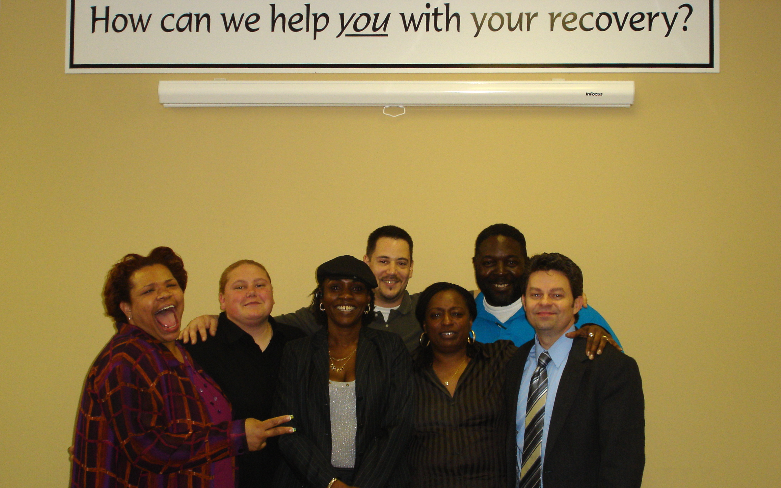
Notes:
127

Slide 128
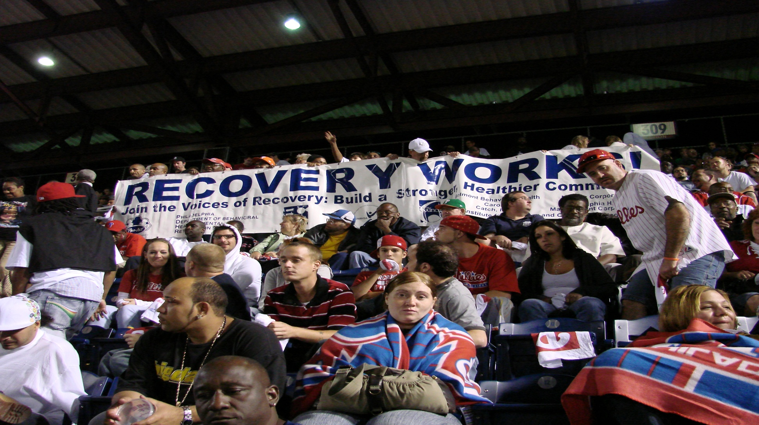

Slide 129
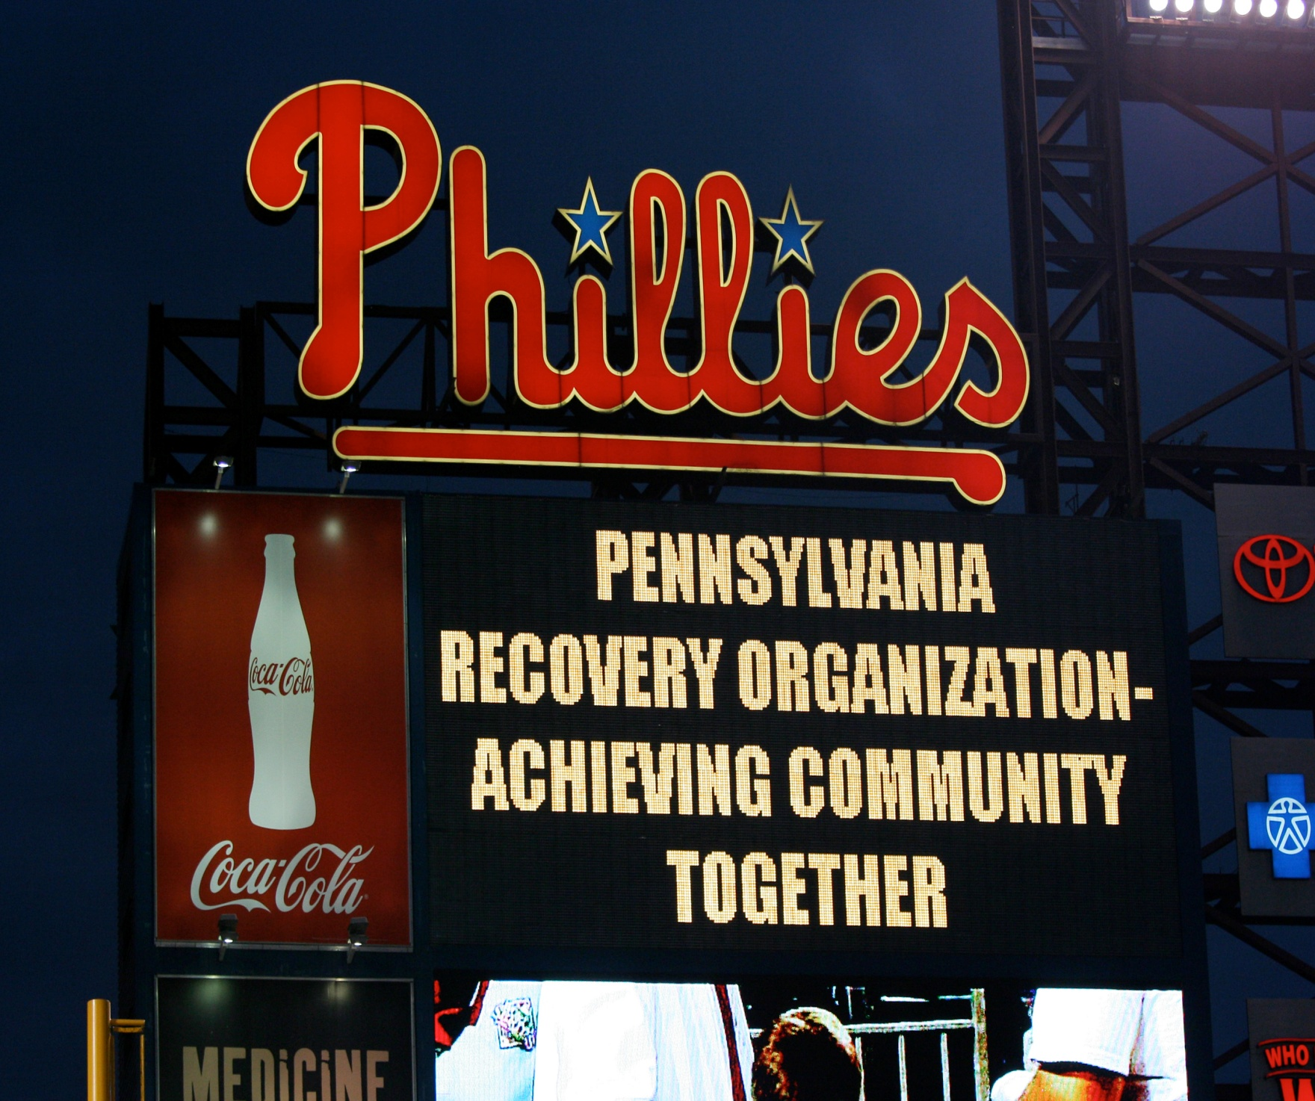

Slide 130
Survey: Ten Percent of American Adults Report Being in Recovery from Substance Abuse or Addiction
By Josie Feliz | March 6, 2012
Data Show More Than 23 Million Adults Living in U.S. Once Had Drug or Alcohol Problems, But No Longer Do
New York, NY, March, 6 2012 – Survey data released today by The Partnership at Drugfree.org and The New York State Office of Alcoholism and Substance Abuse Services (OASAS) show that 10 percent of all American adults, ages 18 and older, consider themselves to be in recovery from drug or alcohol abuse problems. These nationally representative findings indicate that there are 23.5 million American adults who are overcoming an involvement with drugs or alcohol that they once considered to be problematic.

Slide 131
“I have one life and one chance to make it count for something….My faith demands…that I do whatever I can, wherever I am, whenever I can, for as long as I can with whatever I have to try to make a difference.”
-Jimmy Carter
Notes:
131
I would like to leave you with this final thought. I like this quote from Jimmy Carter (read quote). We are in the business of helping people grow in their recovery. What we do is important. Let us do it to the fullest of our abilities.

Slide 132

Transformation is trusting not knowing what it will look like only that we are seeking to make it better.

Slide 133

Transforming
One Day At A Time

