Slide 1


October 1, 2009 — Madison, Wisconsin
RECOVERY SCHOOLS SYMPOSIUM
A Providers’ Introduction to Recovery Programs in High Schools and Post – Secondary Schools

Slide 2

Moving Towards
Evidence Based Practice
Post Secondary Education & Recovery Support
David T. Hadden MA LADC Assistant Director 2000-10/21/2009 StepUP Program Augsburg College Campus Box 82, 2211 Riverside Avenue Minneapolis MN 55454 dhaddeen@tmo.blackberry.net Cell 952-451-2651 http://www.augsburg.edu/stepup/ | Scott Washburn MA LADC Assistant Director 10/22/2009-???? StepUP Program Augsburg College Campus Box 82, 2211 Riverside Avenue Minneapolis MN 55454 Washburn@augsburg.edu 61/2-330-1421 http://www.augsburg.edu/stepup

Slide 3
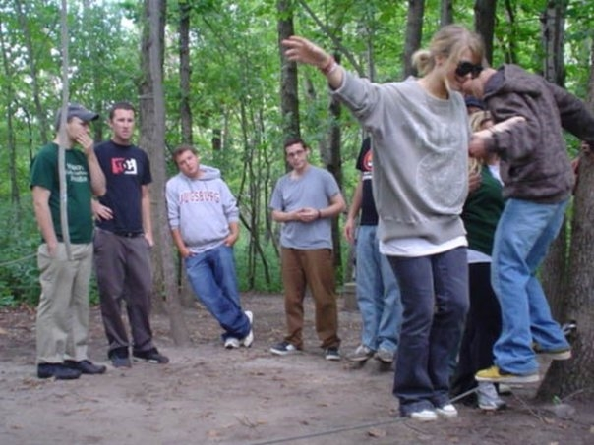
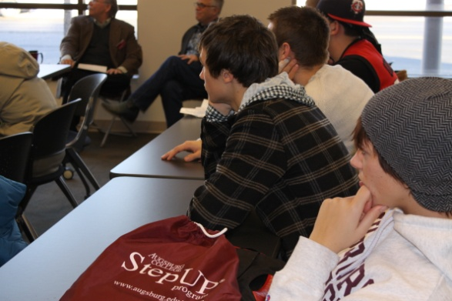
The mission of StepUP®
To help students:
Champion lives of recovery
Achieve academic success
Thrive with community, accountability and support

Slide 4
Higher Education & Substance Use Disorders
The Reality of Substance Use Problems on the College Campus: On an average campus of 30,000 students, nearly 9,500 meet criteria for a substance use disorder (SUD) Harris, 2006.
SUDs rise through teen years peaking between ages 18 and 20, prime college years (Dennis & Scott, 2007).
Adolescent networks with higher density of alcohol and other drug use were “substantially higher” relapse risks for recovering youth (Richter, Brown, & Mott, 1991).

Slide 5
Presentation Goal 1: To provide participants with an overview of Collegiate Recovery Support Programs.
Review evidence based practice of the, NIAA and NREPP.
b. Present Augsburg College StepUP® Program Outcomes from 1997 to present and next stages of national research on program outcomes (Texas Tech University).

Slide 6
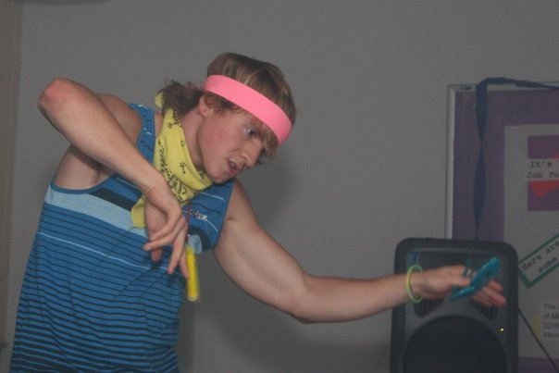
Goal 2. The work of Augsburg College.
Present Minnesota Recovery High School Students education transition needs.
Present our Campus Recovery Coalition.

Slide 7
The Essence of STEPUP®
Growing healthy minds, Achieving academic
emotions and spirituality success and leadership
Living in community Creating and living
(accountability and support) positive community norms
Recovery:
Truth, Goodness,
Well-being

Slide 8
I. StepUP Project Significance:
Youth with diagnosed substance dependence, in recovery can be successful within higher education.
Recovery support can reduce relapse.
Supporting the recovering community shows promise.

Slide 9
II. Evidence of Program Effectiveness:
Demonstrated in our Annual Report 2007-2008.
High abstinence rate of recovering students over 12 years is 84.39%.
Increased Academic Success: Spring Semester the cumulative GPA of students who continued into the fall with the program was 3.3. The average spring GPA of all Augsburg College students was 2.97.

Slide 10
StepUP Outcomes* Duplicated count as students continue year to year
School year including summer, fall and spring semesters | Students Served Yearly * | Relapse Number Yearly | Average Yearly Abstinence Rate | Average Yearly Relapse rate
1997-98 | 36 | 9 | 75% | 25%
1998-99 | 41 | 7 | 83% | 17%
1999-00 | 44 | 8 | 82% | 18%
2000-01 | 46 | 6 | 87% | 13%
2001-02 | 54 | 11 | 80% | 20%
2002-03 | 61 | 10 | 83% | 17%
2003-04 | 83 | 12 | 85.55% | 14.45%
2004-05 | 61 | 5 | 91.80% | 8.19%
2005-06 | 54 | 12 | 79.78% | 20.22%
2006-07 | 56 | 5 | 91.08% | 8.92%
2007-08 | 79 | 8 | 89.88% | 10.12%
2008-09 | 76 | 5 | 93.50% | 6.49%
Average Fall 1997 to Spring 2009 | 57.58 | 8.16 | 85% | 15%

Slide 11
Grade Point Averages of StepUP Students
 | 2005 2006 | 2006 2007 | 2007 2008 | 2008 2009 | GPA Cum 2005 2006 | GPA Cum 2006 2007 | GPA Cum 2007 2008 | GPA Cum 2008 2009
Number of Students | 54 | 56 | 79 | 76 | 2.72 | 2.91 | 3.04 | 3.24
StepUP Student Relapse | 12 | 5 | 8 | 5 | 1.62 | 1.60 | 2.93 | 2.832
Left StepUP ASR* | 5 | 4 | 11 | 6 | 1.88 | 1.28 | 2.42 | 2.671
Left StepUP WSC# | 4 | 4 | 2 | 2 | 2.1 | 2.28 | .75 | 2.262
Graduated StepUP | 17 | 9 | 21 | 21 | 3.03 | 3.18 | 3.02 | 3.369
Returning Students, Presently Enrolled in StepUP | 16 | 34 | 37 | 41 | 2.89 | 3.14 | 3.31 | 3.35
All Present and Past StepUP Students Enrolled In Augsburg College 2008-2009 |  |  |  | 107 |  |  |  | 3.14
Past StepUP Students who graduated from Augsburg 2008-09 |  |  |  | 12 |  |  |  | 3.01
Past StepUP Students Currently enrolled at Augsburg 2008-09 |  |  |  | 18 |  |  |  | 2.82
StepUP Members who graduated from Augsburg Spring 2009 |  |  |  | 6 |  |  |  | 3.32

Slide 12
Student Survey RECOVERY NORMS Support in developing close relationships with sober communities.
 | Strongly Disagree | Disagree | Neutral | Agree | Strongly Agree | Rating Average | Response Count
Adapting to stresses | 0.0% (0) | 0.0% (0) | 23.5% (8) | 55.9% (19) | 20.6% (7) | 3.97 | 34
Getting along with people outside of the family | 0.0% (0) | 0.0% (0) | 17.6% (6) | 50.0% (17) | 32.4% (11) | 4.15 | 34
Dealing with isolation & loneliness | 0.0% (0) | 2.9% (1) | 20.6% (7) | 50.0% (17) | 26.5% (9) | 4.00 | 34
Being able to feel close | 2.9% (1) | 2.9% (1) | 17.6% (6) | 47.1% (16) | 29.4% (10) | 3.97 | 34
Being realistic about yourself and others Relationship to others | 0.0% (0) | 0.0% (0) | 20.6% (7) | 55.9% (19) | 23.5% (8) | 4.03 | 34
Developing independence, autonomy | 0.0% (0) | 2.9% (1) | 14.7% (5) | 50.0% (17) | 32.4% (11) | 4.12 | 34
Staying clean and sober | 0.0% (0) | 0.0% (0) | 2.9% (1) | 35.3% (12) | 61.8% (21) | 4.59 | 34
 | answered question |  |  |  |  |  | 34
 | skipped question |  |  |  |  |  | 1

Slide 13
III. Evidence Based Strategies of StepUP Include:
StepUP has integrated evidence-based practices found in Exemplary, Promising, and Effective programs of SAMHSA’s, National Registry of Evidence-based Programs and Practice http://www.nrepp.samhsa.gov/about-evidence.asp ).
Exemplary program strategies utilize Brief therapy /Motivational interviewing as applied to:
Counseling activities
Student leadership structure of the program
Program judicial affairs.
Actual reduction in alcohol/drug use prevalence Relapse, increased academic success, and behavioral changes.

Slide 14

Post Secondary Education Evidence
Based Practice
Who do we look to?
A Call to Action: Changing the Culture of Drinking at U.S. Colleges
This report, developed by the NIAAA-supported Task Force on College Drinking, discusses binge drinking among college students and its consequences for both drinkers and nondrinkers.
The report outlines recommendations for colleges and universities, researchers, and NIAAA based on scientific evidence and calls for collaboration between academic institutions and researchers.

Slide 15
 | 3-in-1 Framework
Tier | Strategy | Level of Operation
 |  | Individuals, including At-Risk and Dependent Drinkers | Student Population as Whole | Community
1: Effective among college students
2: Effective with general populations
3: Promising
4: Ineffective

Slide 16
The Three Big Questions:
1. What application can effective prevention strategies have to recovery populations in a college setting?
2. What positive community norms within a recovery community on a college campus can be created by the implementation of these strategies?
3. What potential exists with the creation of these positive community norms for influencing the campus community as a whole?

Slide 17
 | 4-in-1 Framework
Tier | Strategy | Level of Operation
 |  | Individual in recovery, disease in remission | Individuals, including At-Risk and Dependent Drinkers | Student Population as Whole | Community
1: Effective among college students | Combining cognitive-behavioral skills with norms clarification & motivational enhancement intervention | Yes | Yes | No | No
 | Offering brief motivational enhancement interventions in student health centers and emergency rooms | Yes | Yes | No | No
 | Challenging alcohol expectancies | Yes | Yes | No | No

Slide 18
Tier 1: Effective: Evidence of Effectiveness among College Students
Brief Therapy/Support (1-1 sessions).
Solution-Focused Model (Peer Review Board).
Peer-to-Peer Recovery
Positive Community Norms (“Filter This” Campaign). Challenging expectancies for StepUP Students.

Slide 19
 | 4-in-1 Framework The Impact of the Recovering Community
Tier | Strategy | Level of Operation
 |  | Individual in recovery, disease in remission | Individuals, including At-Risk and Dependent Drinkers | Student Population as Whole | Community
2: Effective with general populations | The formation of a campus/community coalition | Yes | No | Yes | Yes
 | Adopting campus-based policies to reduce high-risk use (e.g., reinstating Friday classes, eliminating keg parties, establishing alcohol-free activities & dorms) | Yes | No | Yes | No
 | Consistently enforcing campus disciplinary actions associated with policy violations | Yes | No | Yes | No
 | Conducting marketing campaigns to correct student misperceptions about alcohol use on campus | Yes | No | Yes | No

Slide 20
Tier 2: Effective: Evidence of Success with general populations applied to college environments
Strategy: The formation of a campus and community coalition involving all major stakeholders.
Student Government – Leadership Team, Review Board, Governing Board
Leadership Development – on and off campus trainings, peer to peer support.
Campus Recovery Coalition (CRC) – Augsburg faculty and staff

Slide 21
Level of concern you have for StepUP Program STUDENTS (academic and recovery issues)
Faculty Staff Perceptions | Low |  |  |  | High | Rating Average | Response Count
Over extended | 20.5% (9) | 34.1% (15) | 38.6% (17) | 4.5% (2) | 2.3% (1) | 2.34 | 44
Prepared for academic rigor | 20.5% (9) | 29.5% (13) | 22.7% (10) | 18.2% (8) | 9.1% (4) | 2.66 | 44
Ability to live independently | 20.5% (9) | 22.7% (10) | 36.4% (16) | 18.2% (8) | 2.3% (1) | 2.59 | 44
Ability to balance recovery and academics | 18.2% (8) | 25.0% (11) | 29.5% (13) | 18.2% (8) | 9.1% (4) | 2.75 | 44
Ability to manage co-occurring disorders | 6.8% (3) | 29.5% (13) | 27.3% (12) | 31.8% (14) | 4.5% (2) | 2.98 | 44
Fitting in with general population students | 27.3% (12) | 25.0% (11) | 20.5% (9) | 18.2% (8) | 9.1% (4) | 2.57 | 44
Using StepUP as a justification for poor academic performance or absenteeism | 50.0% (22) | 18.2% (8) | 22.7% (10) | 4.5% (2) | 4.5% (2) | 1.95 | 44
Relapse - medical withdrawals - retention | 15.9% (7) | 29.5% (13) | 36.4% (16) | 9.1% (4) | 9.1% (4) | 2.66 | 44

Slide 22
To what extent are the following elements of the StepUP Program apparent/visible Table 5.1
RECOVERY NORMS | Low |  |  |  | High | Rating Average | Response Count
Goal oriented students | 4.5% (2) | 0.0% (0) | 15.9% (7) | 47.7% (21) | 31.8% (14) | 4.02 | 44
Supportive community | 2.3% (1) | 0.0% (0) | 2.3% (1) | 29.5% (13) | 65.9% (29) | 4.57 | 44
Students have a desire to serve | 2.3% (1) | 9.1% (4) | 38.6% (17) | 25.0% (11) | 25.0% (11) | 3.61 | 44
A collaborative approach exists | 2.3% (1) | 11.4% (5) | 11.4% (5) | 47.7% (21) | 27.3% (12) | 3.86 | 44
Community outreach is a high priority | 6.8% (3) | 18.2% (8) | 29.5% (13) | 29.5% (13) | 15.9% (7) | 3.30 | 44

Slide 23
 | 4-in-1 Framework
Tier | Strategy | Level of Operation
 |  | Individual in recovery, disease in remission | Individuals, including At-Risk and Dependent Drinkers | Student Population as Whole | Community
3: Promising | Enhancing awareness of personal liability | Yes | Yes | Yes | Yes
 | Informing new students and parents about alcohol policies and penalties | Yes | Yes | Yes | No

Slide 24
Tier 3: Promising: Evidence of logical and theoretical promise, but require more comprehensive evaluation.
Strategies: Adopting campus-based policies and practices that appear to be capable of reducing high-risk alcohol use including alcohol-free, Expanded late-night student activities.
Substance free student housing.
Employing salaried (older/senior recovering) students with academic success to help guide students newer to recovery.

Slide 25
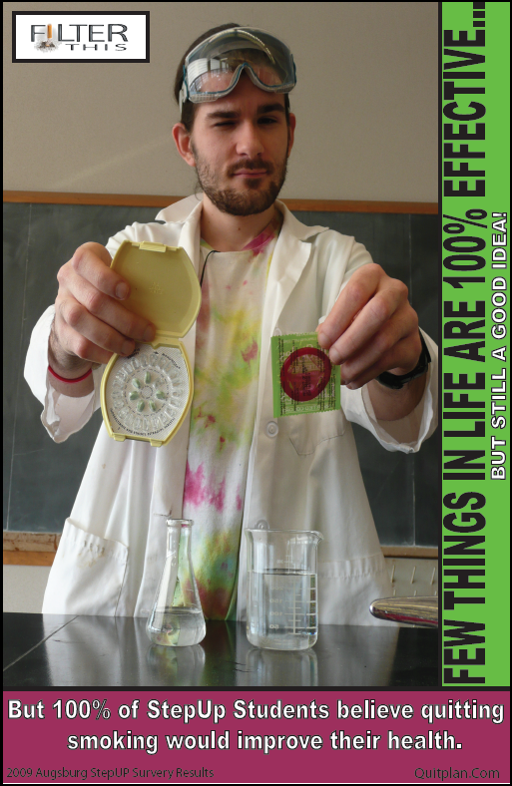
Tier 3: Promising
Marketing campaigns to correct student misperceptions about addiction and recovery .
Informing new students and their parents about alcohol policies and penalties before arrival and during orientation periods.
Consistently enforcing disciplinary actions associated with policy violations

Slide 26
Evidence Based Practice
Michael Dennis, Ph.D.
Chestnut Health Systems
Application of early working research NIAAA and National Registry of Evidence Based Programs
Texas Tech University Study: Targets clients served by post secondary education programs, the programs and outcomes of the programs.
GAIN quality assurance procedures NREBP
Evaluation of performance and outcomes
For the Individual Collegiate Program
Collective information from all partners
Study Information gathered over time of 5 years
Evaluate information components unique to each program
Follow trials of evidence strategies program components
Development of a best practices model which will lead to long term research protocols.
Reliability
GAIN individual and group clinical profiles guide appropriate placement in recovery support services.
At the program level to drive program evaluation, needs assessment, performance monitoring and long term program planning

Slide 27
Minnesota
Recovery High School Survey
We developed and administered a needs assessment to over 150 high school students in recovery in the Minneapolis and St. Paul metro area.

Slide 28
Level of College Preparation
Data showed a mean of 275 days attendance at the recovery high school and mean of 470 days of sobriety.
9.8% had taken an ACT/SAT Prep Course
2.6% had written a college application essay
1.3% had completed FAFSA Applications
76% had never attended a College Fair

Slide 29
Recovering Student Needs
Postsecondary educational options and transition planning.
Resources and tools to aid them in exploring postsecondary education.
An array of post high school options which included trade schools, technical and community colleges, and two and four year colleges and universities.

Slide 30
Internet links
The StepUP® Program http://www.augsburg.edu/stepup/
Networking for Change: Recovery and Education http://www.augsburg.edu/stepup/Networking_for_Chang.html
Called to Serve: Educational Opportunities and Foundational Steps - President Pribbenow and Patrice Salmeri
Keynote Presentation: Pathways of Recovery from Adolescent Drug Addiction - Ken Winters, PhD
Foundation for Leadership in Recovery - Paulette Lack
Special Needs of Recovery Students - Karena Jones
High School Transition: Needs of Recovering Students - Patrice Salmeri
Partnerships in Progress: A Panel Discussion
Academic and College Transition Support for Recovering Students: A Roundtable Discussion
Networking for Change: Recovery Housing Enhancing Student Success - Amanda Erdman and Ericka Otterson
Protecting Recovery: Preparing Youth for Educational and Occupational Success - David Hadden
Newsletters
http://web.augsburg.edu/stepup/pdf/newsletter.pdf
http://web.augsburg.edu/stepup/pdf/newsletter_winter07.pdf
http://web.augsburg.edu/stepup/pdf/newsletter_summer07.pdf
Web
http://www.insidehighered.com/news/2007/12/18/augsburg
http://www.miusa.org/publications/books/nonapparentdisabilities/disclosure
http://www.cnn.com/2009/HEALTH/04/13/addiction.recovery.school.teens/index.html
http://dialogue.samhsa.gov/samhsa_communications_dia/association-of-recovery-schools.html
http://www.facebook.com/pages/Association-of-Recovery-Schools-ARS/107855056153
http://www.tresearch.org/archives/2008Apr_WintersJMATE.pdf
http://www.chestnut.org/li/gain/GCC_Insider/GCC_Insider_issue4.pdf
Binge Drinkig http://www.collegedrinkingprevention.gov/

Slide 31
Dimensions of Recovery Outcomes, Diversity Considerations
Augsburg StepUP Collegiate Recovery Model
Scott Washburn, M.A., LADC
Physical health
  Maintains adequate daily hygiene practices.
  Maintains adequate level of physical fitness.
  Maintains proper nutrition and avoids overuse of caffeine, energy drinks, etc.
  Appropriately manages any personal medical issues (e.g. diabetes, hepatitis, etc.).
  Avoids contraction of any preventable medical illnesses (e.g. STD’s.).
Academic functioning
  Attends classes consistently.
  Maintains at least 2.5 gpa or better.
  Demonstrates effective study skills.
Emotional/Mental Health functioning
  Practices healthy stress management techniques.
  Maintains healthy levels of mood, concentration, energy and sleep.
  Appropriately manages any mental health issues by taking medication as prescribed.
  Consistently attends recommended therapy sessions and psychiatric medication check-ups.
Social and Cultural Partnerships
  Maintains positive, meaningful peer relationships.
  Maintains routine of healthy and fun recreational/social activities.
  Maintains healthy and meaningful significant other relationships.
  Consistently attends self-help and cultural support for recovery (12 Step programs as A.A., N.A., C.A., Alanon). Alternative recovery support programs which have been on the periphery of StepUP include Faith Based as Teen Challenge, Rational Recovery, Narcanon, White Bison, Nation of Islam.
Positive Contributing Citizenship
  Regular involvement with service work in community (AA sponsorship, recovery mentors, speaking opportunities, overall community involvement).
  Participation in leadership opportunities (Augsburg College Student Leadership, Peer to Peer Recovery Communities, Ed opportunities, etc.).
Spiritual Well-Being
  Maintaining a sense of meaning and purpose in life.
  Maintaining involvement and connection to a community (AA, Faith Fellowship, recovery programs, church, faith based etc.).
Vocational/Educational Future Goal Preparation
  Successfully maintaining part-time employment while in school.
  Successfully participating in internships related to academic major.
  Successfully attainment of employment in academic major-related field post-graduation.
  Completion of satisfactory resume prior to graduation from college.
  Successful preparation (GRE’s) and admission to graduate school program.
Financial functioning
  Consistently maintains lifestyle within budget.
  Responsibly handles debt (e.g. credit cards, ATM, etc.).
Legal Status functioning
  Responsibly handles outstanding legal issues towards successful resolution (e.g. Probation requirements).
  Avoids further legal infractions and entanglements.

Slide 32
Resources:
Knight, J. R., Wechsler, H., Kuo, M., Seibring, M., Weitzman, E. R., & Schuckit, M. (2002). Alcohol abuse and dependence among U.S. college students. Journal of Studies on Alcohol, 63, 263-270.
Dennis, M., & Scott, C. K. (2007). Managing addiction as a chronic condition. Addiction science and clinical practice, 4(1), 45-55.
Harris, K. (2006). Why are recovery communities important? Retrieved April 13, 2006, from http://www.texastech.edu/news/CurrentNews/display_article.php?id=2081
Dennis, M. (2004). What works: Advances in adolescent substance abuse treatment and research. Paper presented at the SAMHSA National Policy Academy on Co-Occurring Mental and Substance Abuse Disorders, April 14-16, 2004, Baltimore, MD.
Richter, S. S., Brown, S. A., & Mott, M. A. (1991). The impact of social support and self-esteem on adolescent substance abuse treatment outcomes. Journal of Substance Abuse, 3(4), 371-385.
Past Conference Presentations
Higher Education Center Conference 2002, Recovery as a Prevention Technology on the College Campus, Organizational Participants: Texas Tech, Rutgers, and Augsburg College
Independent Education Consultants, Fall 2005 in Philadelphia presented with Lisa Laitman Rutgers University. May 17, 2008 Minneapolis, MN IECA Conference "Getting into Recovery, Living in Recovery and Thriving in Recovery."
JMATE: Joint Meeting on Adolescent Treatment Effectiveness

